Slide 1
Transfer Learning Transfer Learning through Semi-supervised Deep Generative Models

Slide 2
Outline
Quick review of Neural Networks
Representation Learning
Autoencoders
Variational autoencoders

Slide 3
Autoencoders

Slide 4
Neural Networks

Slide 5
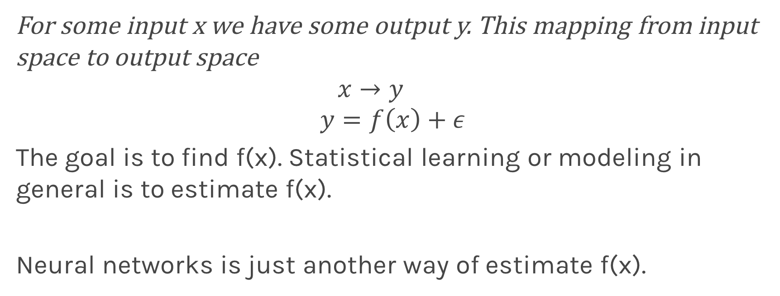
Quick Review
For some input x we have some output y. This mapping from input space to output space
$$x→y \\ y=f\left(x\right)+ε$$
The goal is to find f(x). Statistical learning or modeling in general is to estimate f(x).
Neural networks is just another way of estimate f(x).

Slide 6
Quick Review (cont)
Input x couldbe images and output y could be class
Cat
Dog

Slide 7
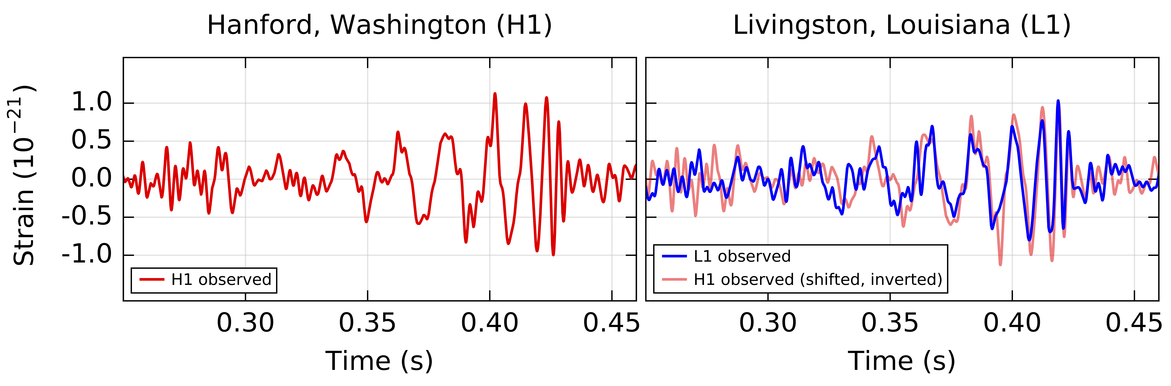
Quick Review (cont)
Input x signal from a sensor, e.g. gravitational wave, output could be if it is true or a glitch

Slide 8
Quick Review (cont)
Input could be even simpler, height, gender, nationality and output the weight.

Slide 9
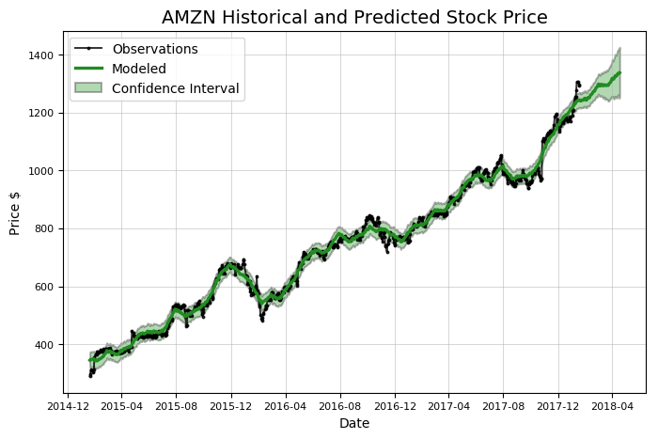
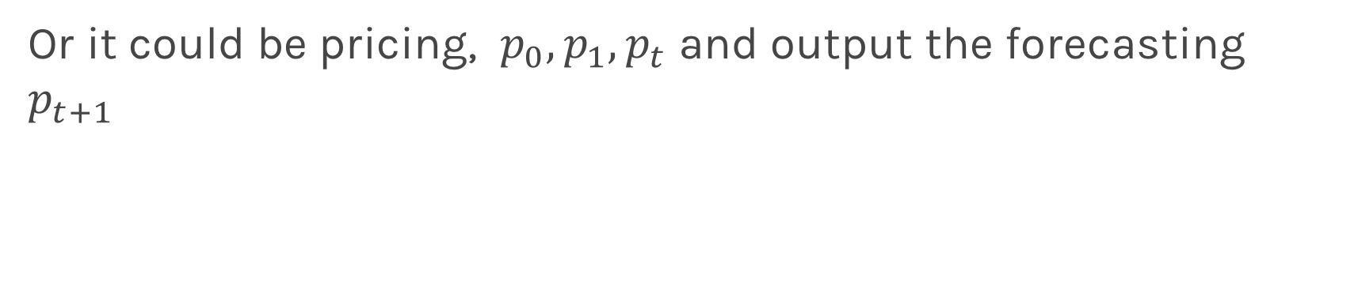
Quick Review (cont)
Or it could be pricing, $p_{0},p_{1},p_{t}$ and output the forecasting $p_{t+1 }$

Slide 10
Quick Review (cont)
Common architectures
Add fully connected networks,
CNN,
RNN,
Bidirectional etc
Fancy one

Slide 11
Representation learning
Cat/Dog

Slide 12
Representation learning
Cat/Dog

Slide 13
Representation learning
Color
Hue
Cat/Dog

Slide 14
Representation learning: How
Minimize the loss function and learn the representation and task at the same time
Color
Hue
Cat/Dog

Slide 15
Representation learning: How
Minimize the loss function and learn the representation and task at the same time
Cat/Dog

Slide 16
Representation learning: How
Force it to learn the features we believe are relevant. Physics maybe an important factor here
Color
Hue
Cat/Dog

Slide 17
Supervised vs Unsupervised
Enough information in the middle
Latent space z
Color
Hue
x
z=f(X)
x’=g(z)
Learn both f(x) and g(z) by comparing x,x’

Slide 18
What are autoencoders
A particular kind of learning architectures.
A mechanism of compressing its input in a form that can be decompressed.
Similar to MP3 that compresses music and JPG that compresses images.
Autoencoders are more general than MP3 or JPG.
Usually is used to reduce the dimensionality of the data or find a representation that is better for another task.
They are also used to blend inputs from one input to another.
Commonly used for denoising

Slide 19
History
MP3 can compress music files by a factor of 10, so it allowed to burn CDs or MP3-players to store a lot of music.
Same with JPG, compresses images by a factor of 10-20.
This helped lead to the image-rich web and abundance of music that we enjoy today.
We say that both MP3 and JPG take an input (a music or image file), and encode it into a compressed form.
Then we decode or decompress the intermediate version to some lower quality original version.

Slide 20
Lossless and Lossy Encoding
The greater the difference of the original version and the decompressed version the greater the loss.
For example imagine you are in Boston and it is cold and want to write a text to a friend who is having her birthday.
HANNAH HAPPY BIRTHDAY BEST WISHES DAN
Boston is cold (-20C) and I do not want to have my hands out in the cold, so I want to shorten the message. I can remove all vowels
HNNH HPP BRTHD BST WSHS FRM DN
I started with 46 characters and compress them to 29

Slide 21
Lossless and Lossy Encoding (cont)
HPP BRTHD is unambiguous, but DN could mean Dan or Diane.
A way to test if a transformation is lossy or lossless is to consider if it can be inverted, or run backwards, to provide us with the original data.

Slide 22
MP3 and JPG on an image
original
MP3
JPG
Original image 256x256=262,000, MP3=37,000, and JPG=26,000
Image taken from A. Glassner, Deep Learning, Vol. 2: From Basics to Practice

Slide 23
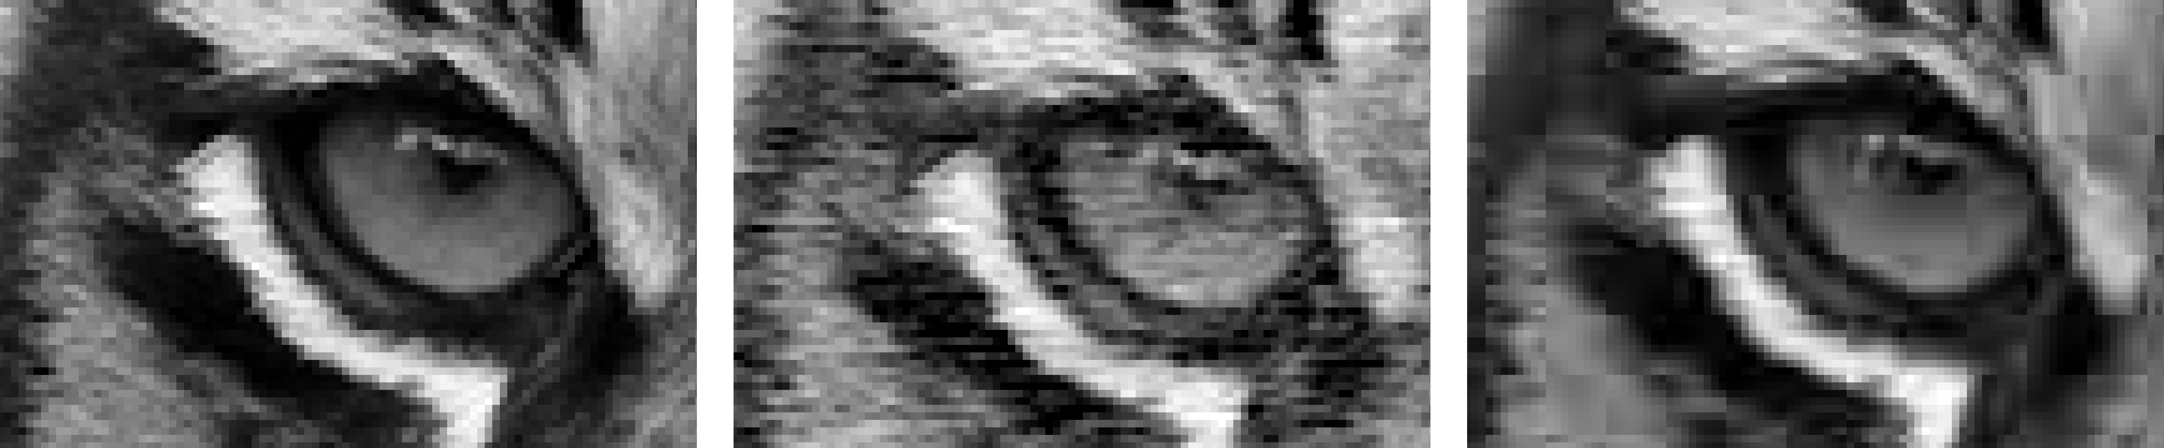
MP3 and JPG on an image (cont)
original
MP3
JPG
Image taken from A. Glassner, Deep Learning, Vol. 2: From Basics to Practice

Slide 24
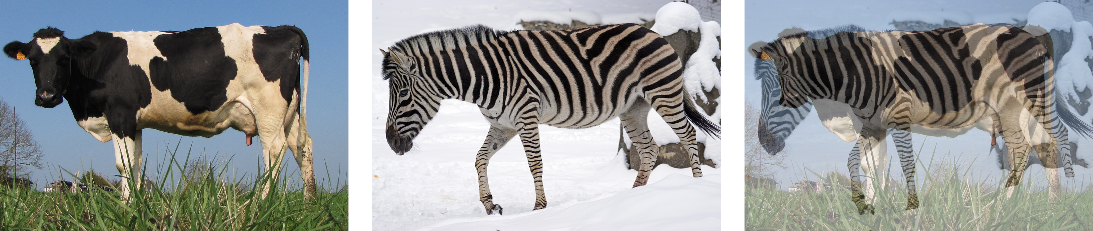
Blending
Blend inputs to create new data that is like the input data, but different.
Content blending. That’s where we blend the content of two pieces of data with each other. For example, if we place a cow and zebra over one another
Image taken from A. Glassner, Deep Learning, Vol. 2: From Basics to Practice

Slide 25
Blending (cont)
Parametric or representation blending:
Work with parameters that describe the object we’re interested in. By blending two sets of parameters, depending on the nature of the parameters and the algorithm we use to create the object, we can create results that blend the inherent qualities of the things themselves

Slide 26
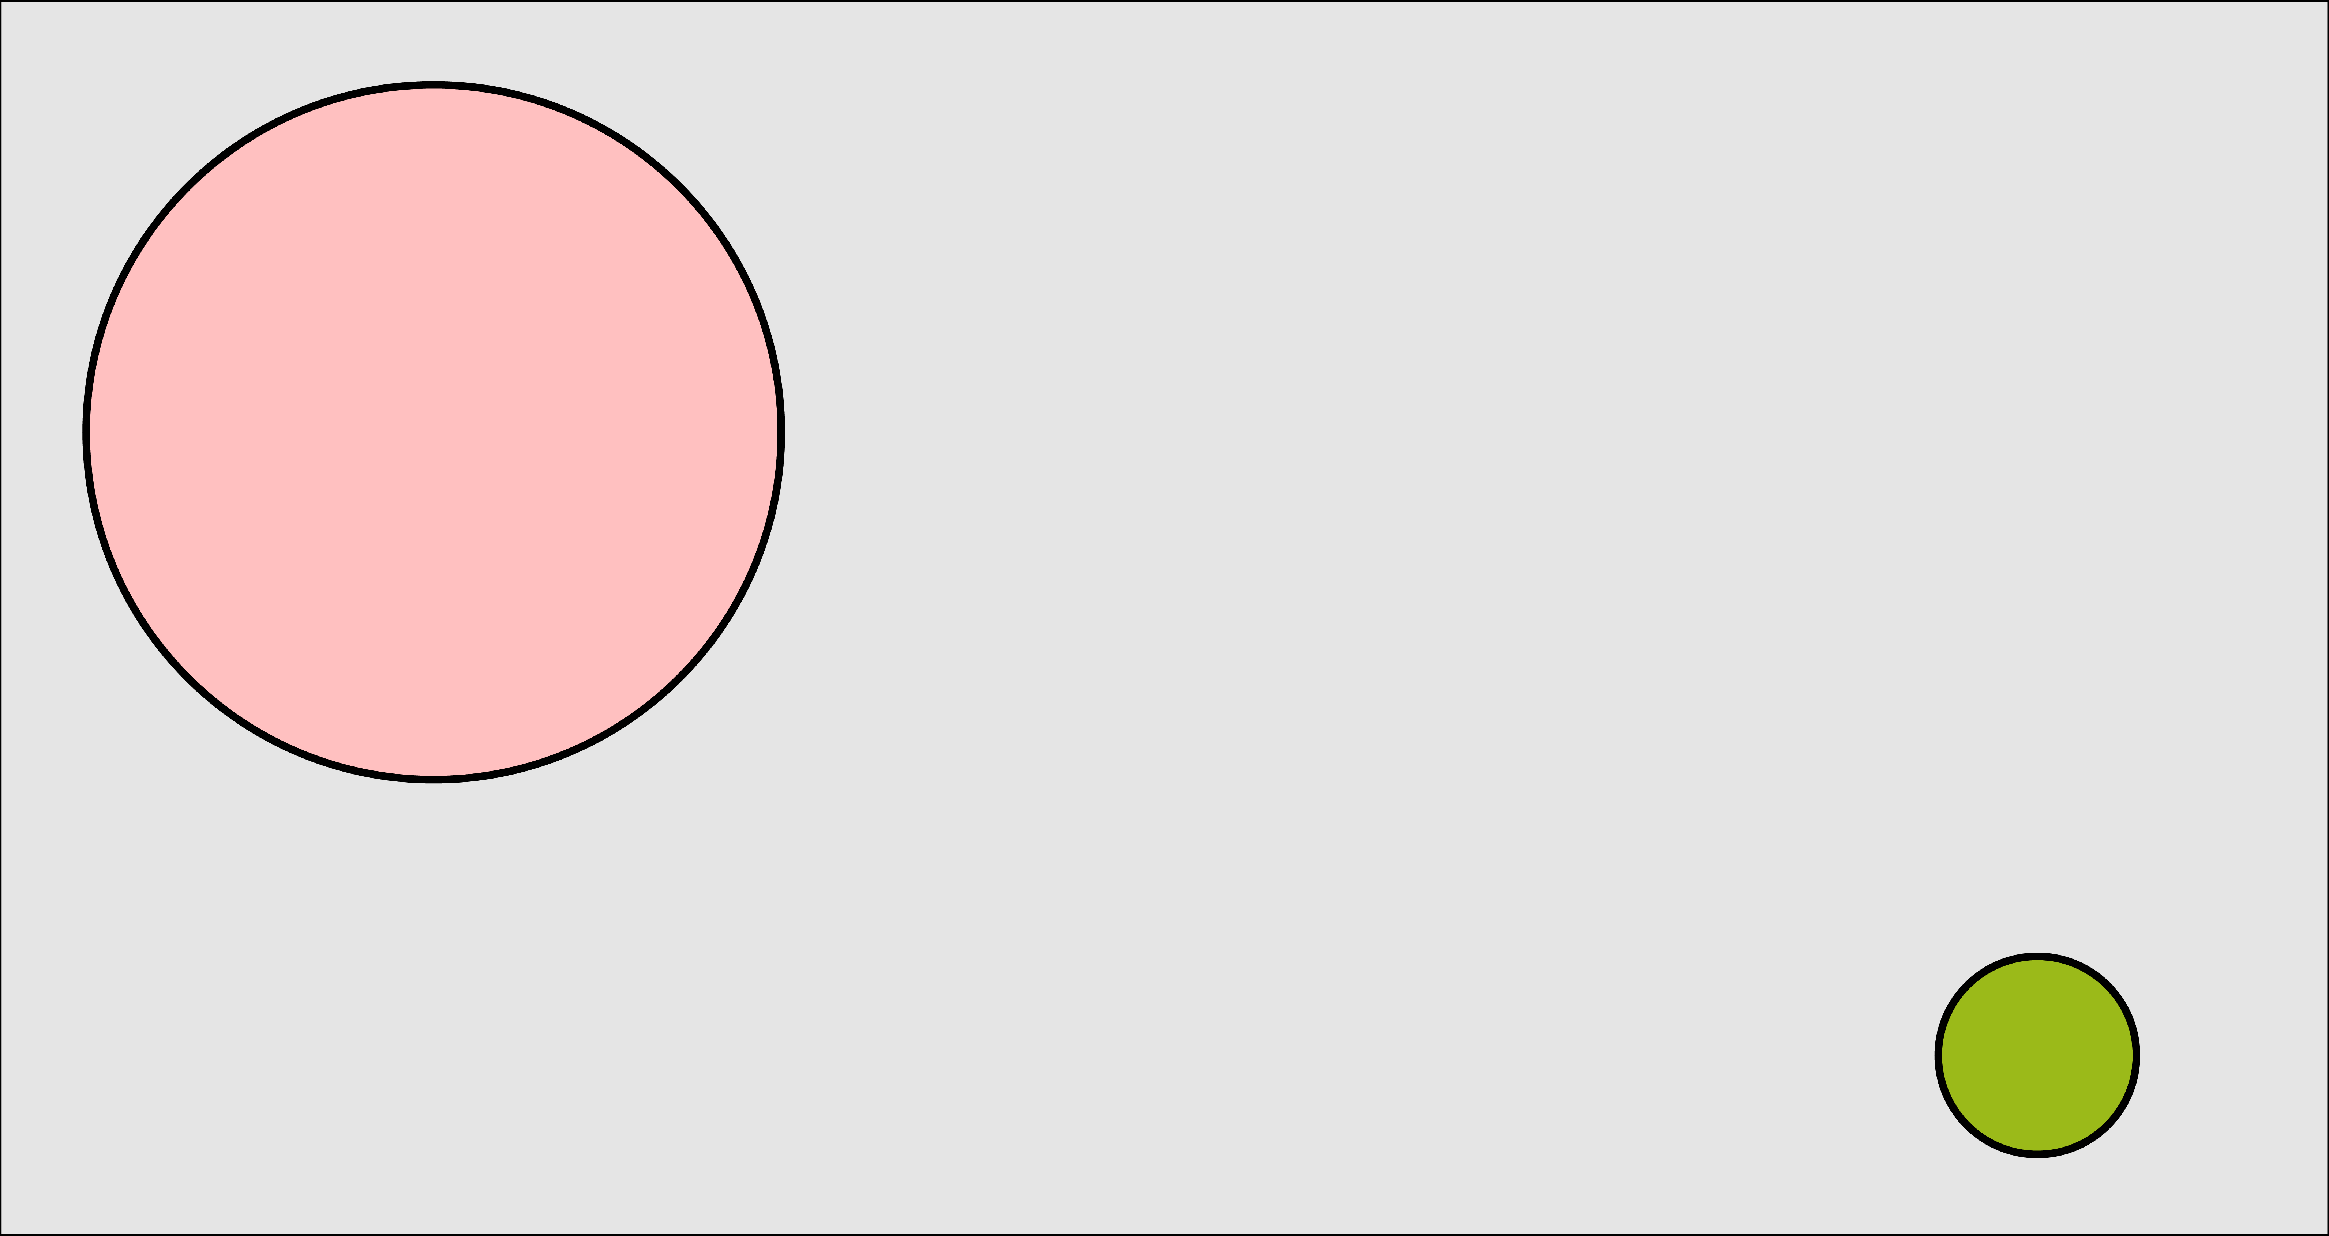
Blending (cont)
Image taken from A. Glassner, Deep Learning, Vol. 2: From Basics to Practice

Slide 27
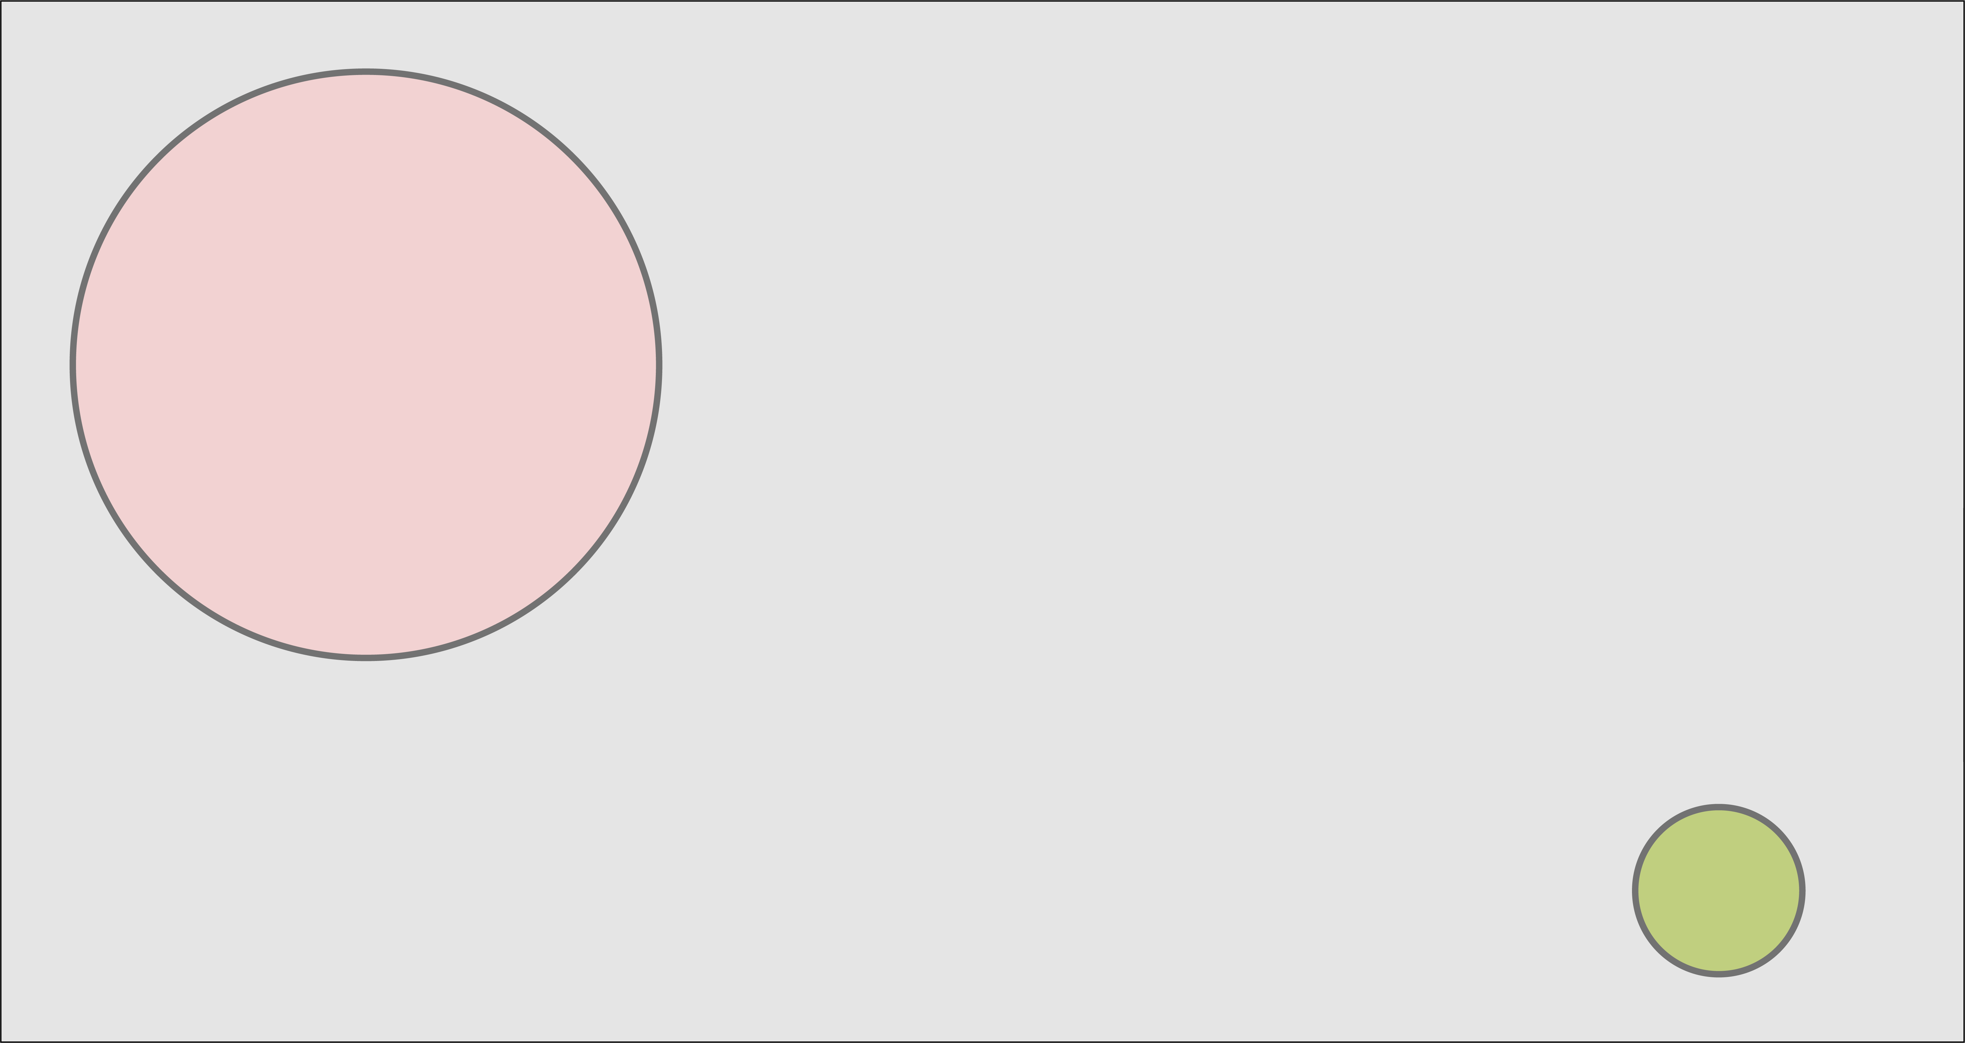
Content blending
Image taken from A. Glassner, Deep Learning, Vol. 2: From Basics to Practice

Slide 28
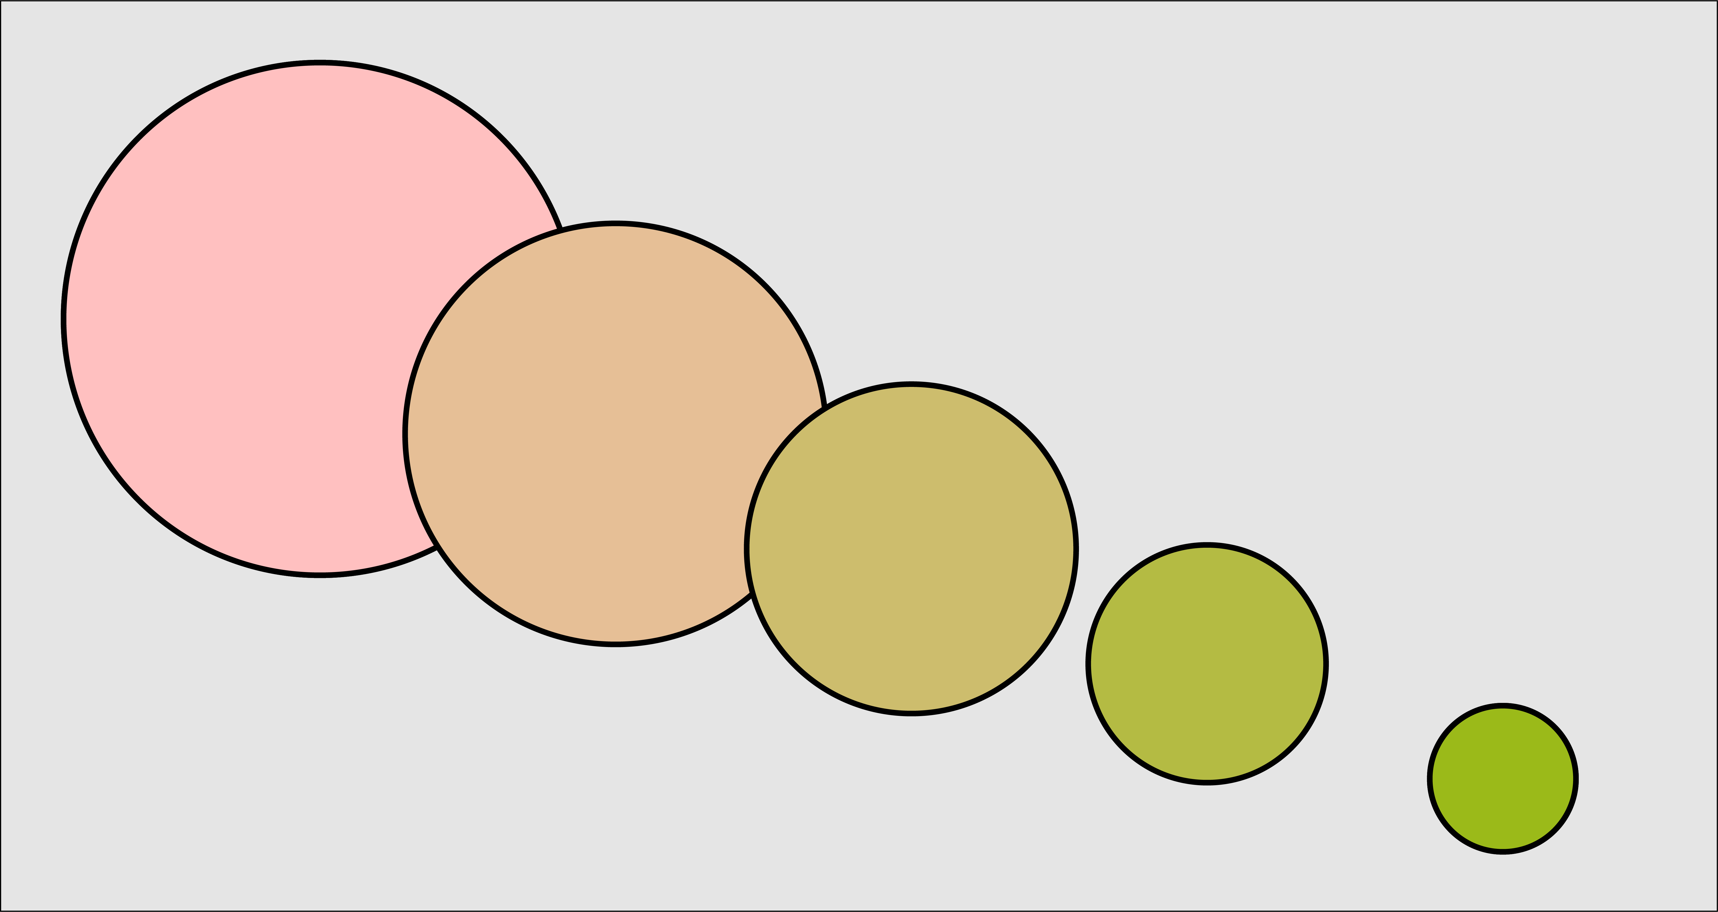
Parametric or representation blending
Image taken from A. Glassner, Deep Learning, Vol. 2: From Basics to Practice

Slide 29
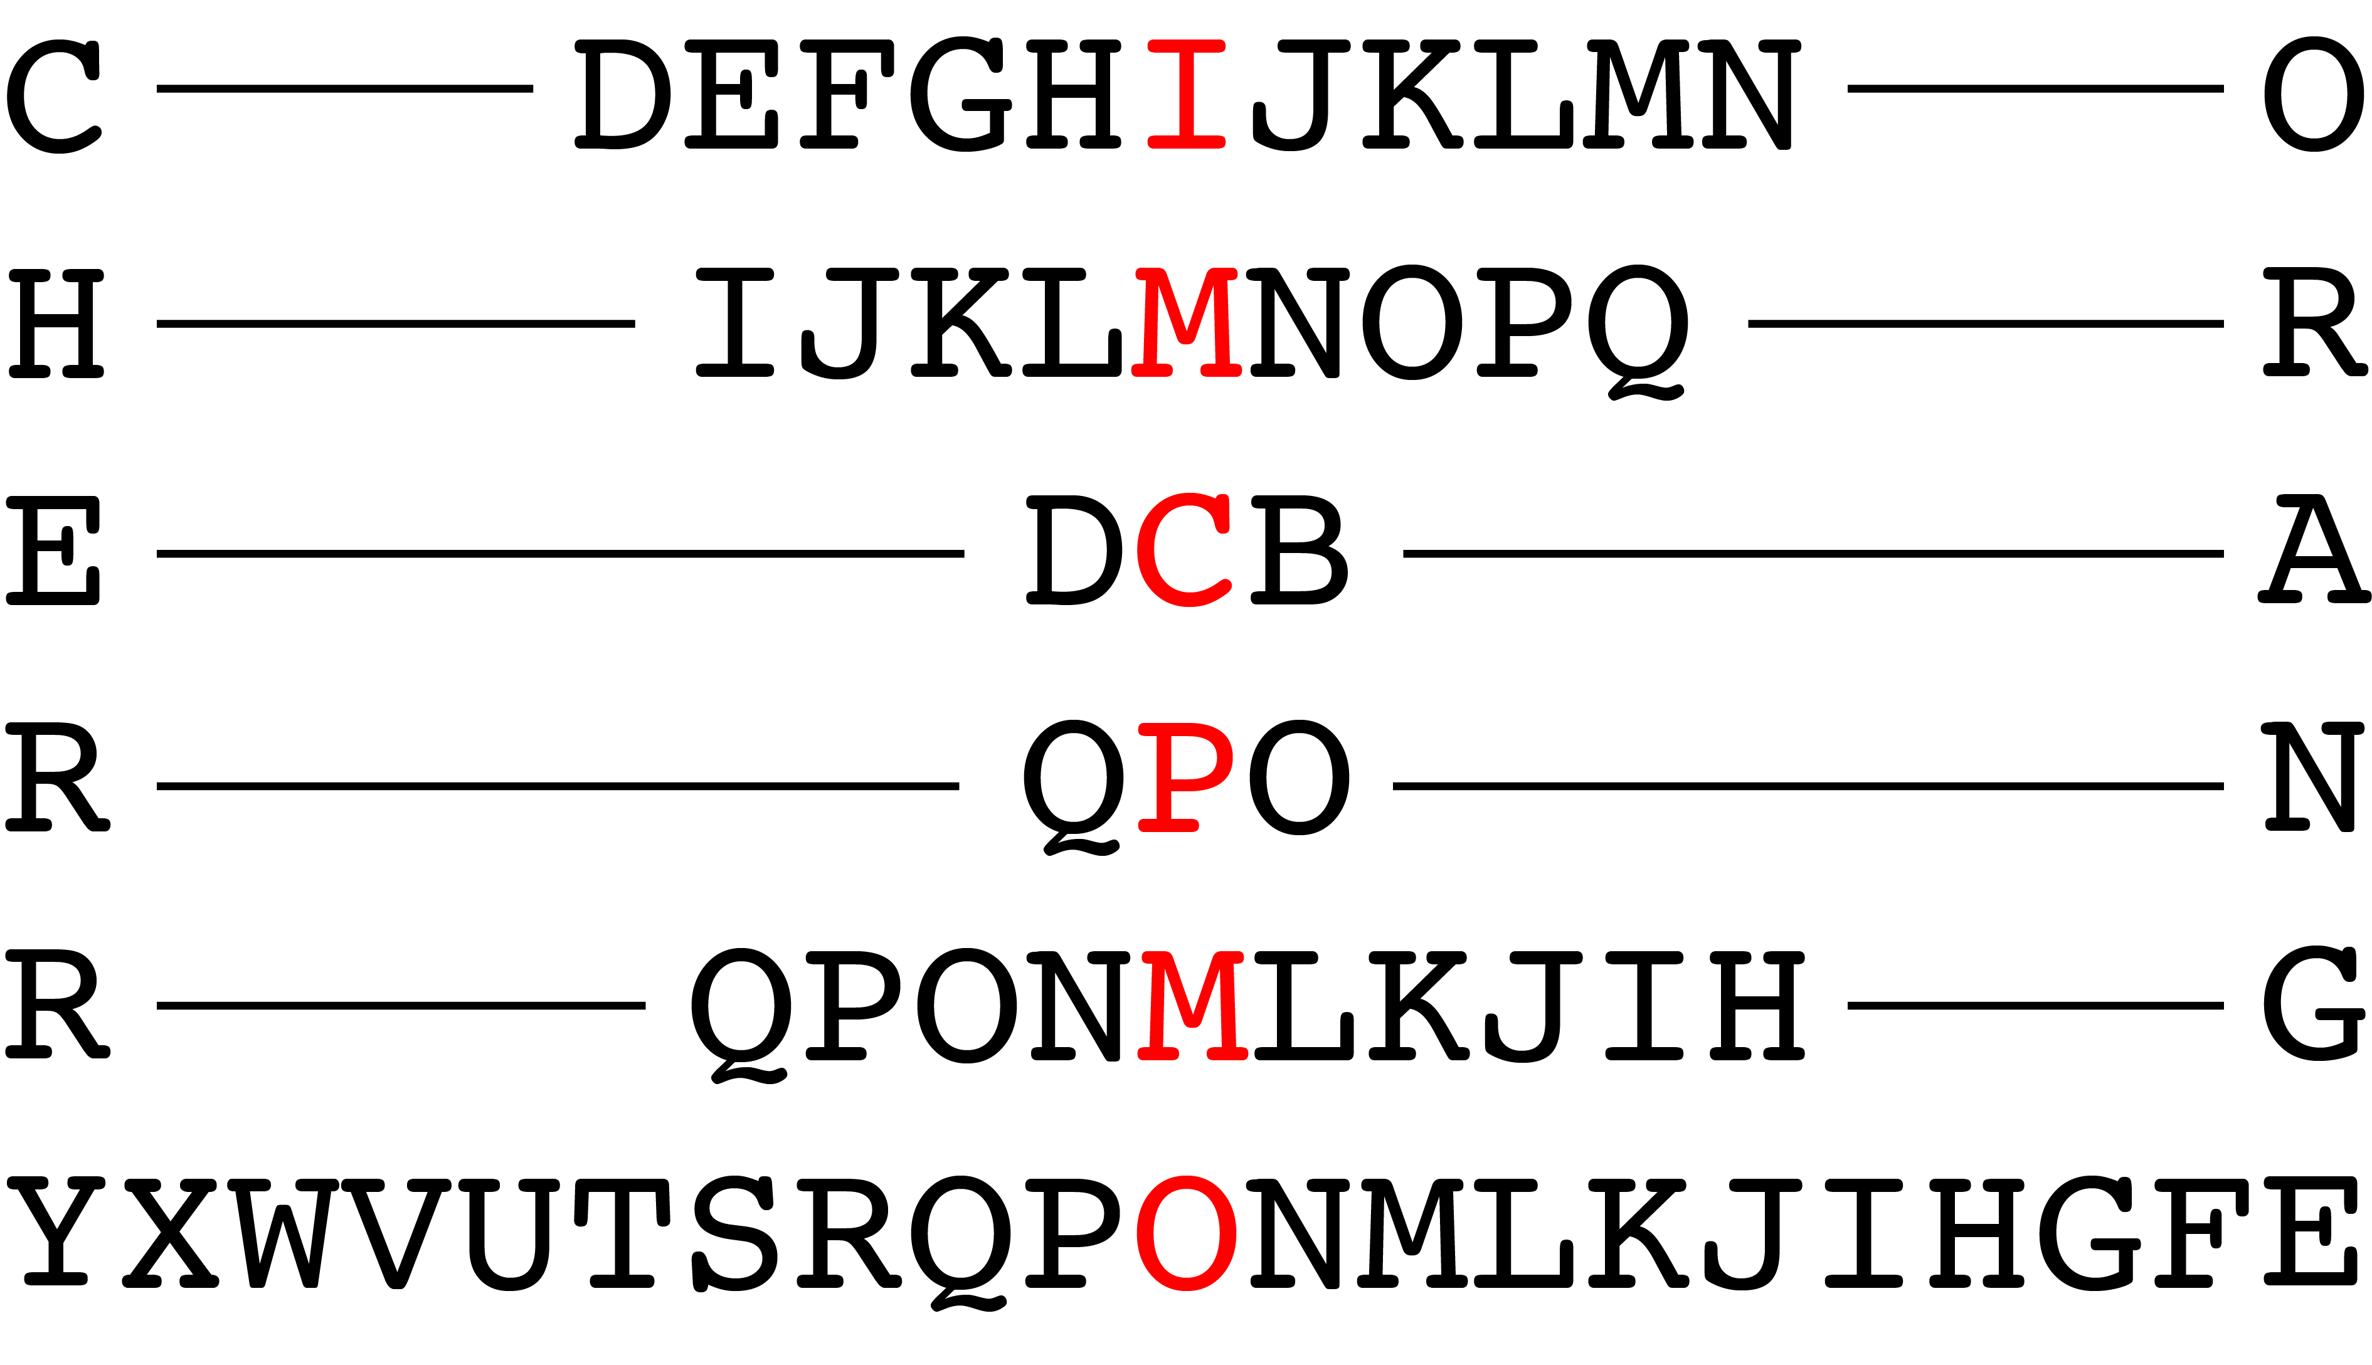
Blending in compressed representation
This works well for uncompressed objects.
What if we try this with compressed objects. The compressed form may not be the best representation with what we would like to blend the objects.
For example, let’s take the sounds of the words cherry and orange.
We can blend these sounds together or we can compressed these sounds into written words.
Image taken from A. Glassner, Deep Learning, Vol. 2: From Basics to Practice

Slide 30
The simplest autoencoder
Encode with a simple fully connected network (FCN)
20 neurons
20 numbers
Image 100x100
FCN with 20 neurons

Slide 31
The simplest autoencoder
Encode and decode
20 neurons
10K neurons
10000 numbers
Image 100x100
FCN: 20 neurons
FCN:10000 neurons
This is an autoencoder. It gets that name because it automatically finds the best way to encode the input so that the decoded version is as close as possible to the input.

Slide 32
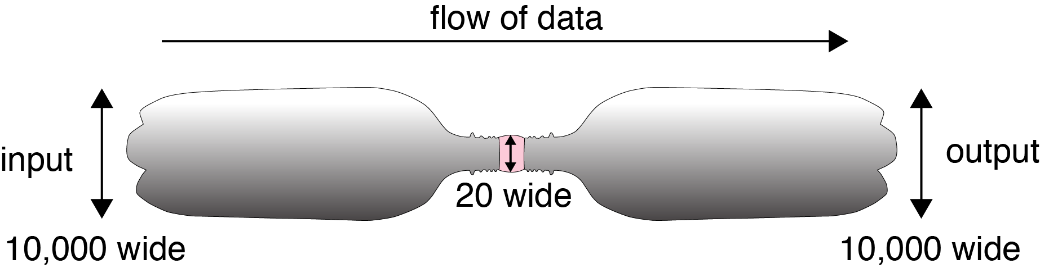
Bottleneck
We start with 10,000 elements
We have 20 in the middle
And 10,000 elements again at the end

Slide 33
Latent variables and latent layer
We say that an autoencoder is an example of semi-supervised learning. It sort-of is supervised learning because we give the system explicit goal data (the output should be the same as the input), and it sort-of isn’t supervised learning because we don’t have any manually determined labels or targets on the inputs.

Slide 34
Autoencoders in action

Slide 35
Autoencoders in action (cont)
20 neurons
10K neurons
Pretty good I say

Slide 36
Autoencoders in action (cont)
20 neurons
10K neurons
Even better

Slide 37
Autoencoders in action (cont)
20 neurons
10K neurons
Hmmmmm

Slide 38
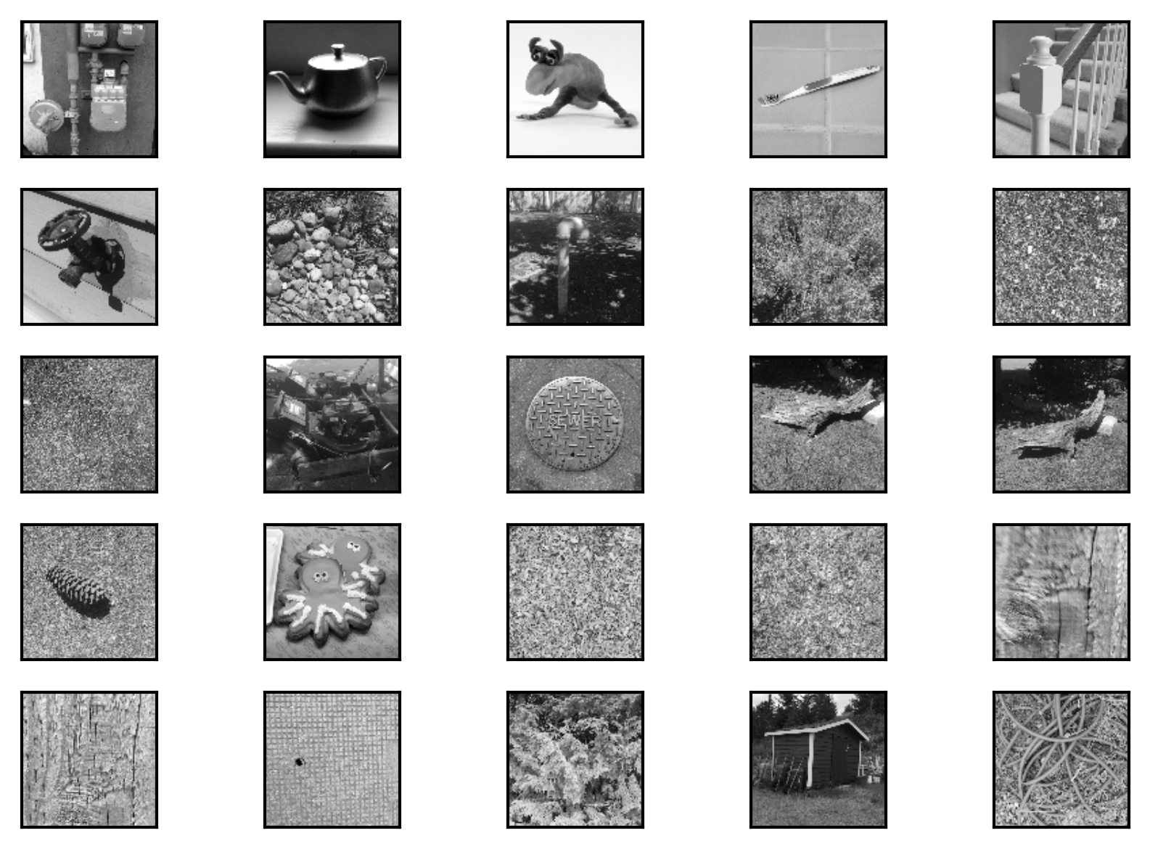
Autoencoders in action (cont)
We must train with a variety of images.

Slide 39
Autoencoders in action (cont)
20 neurons
10K neurons

Slide 40
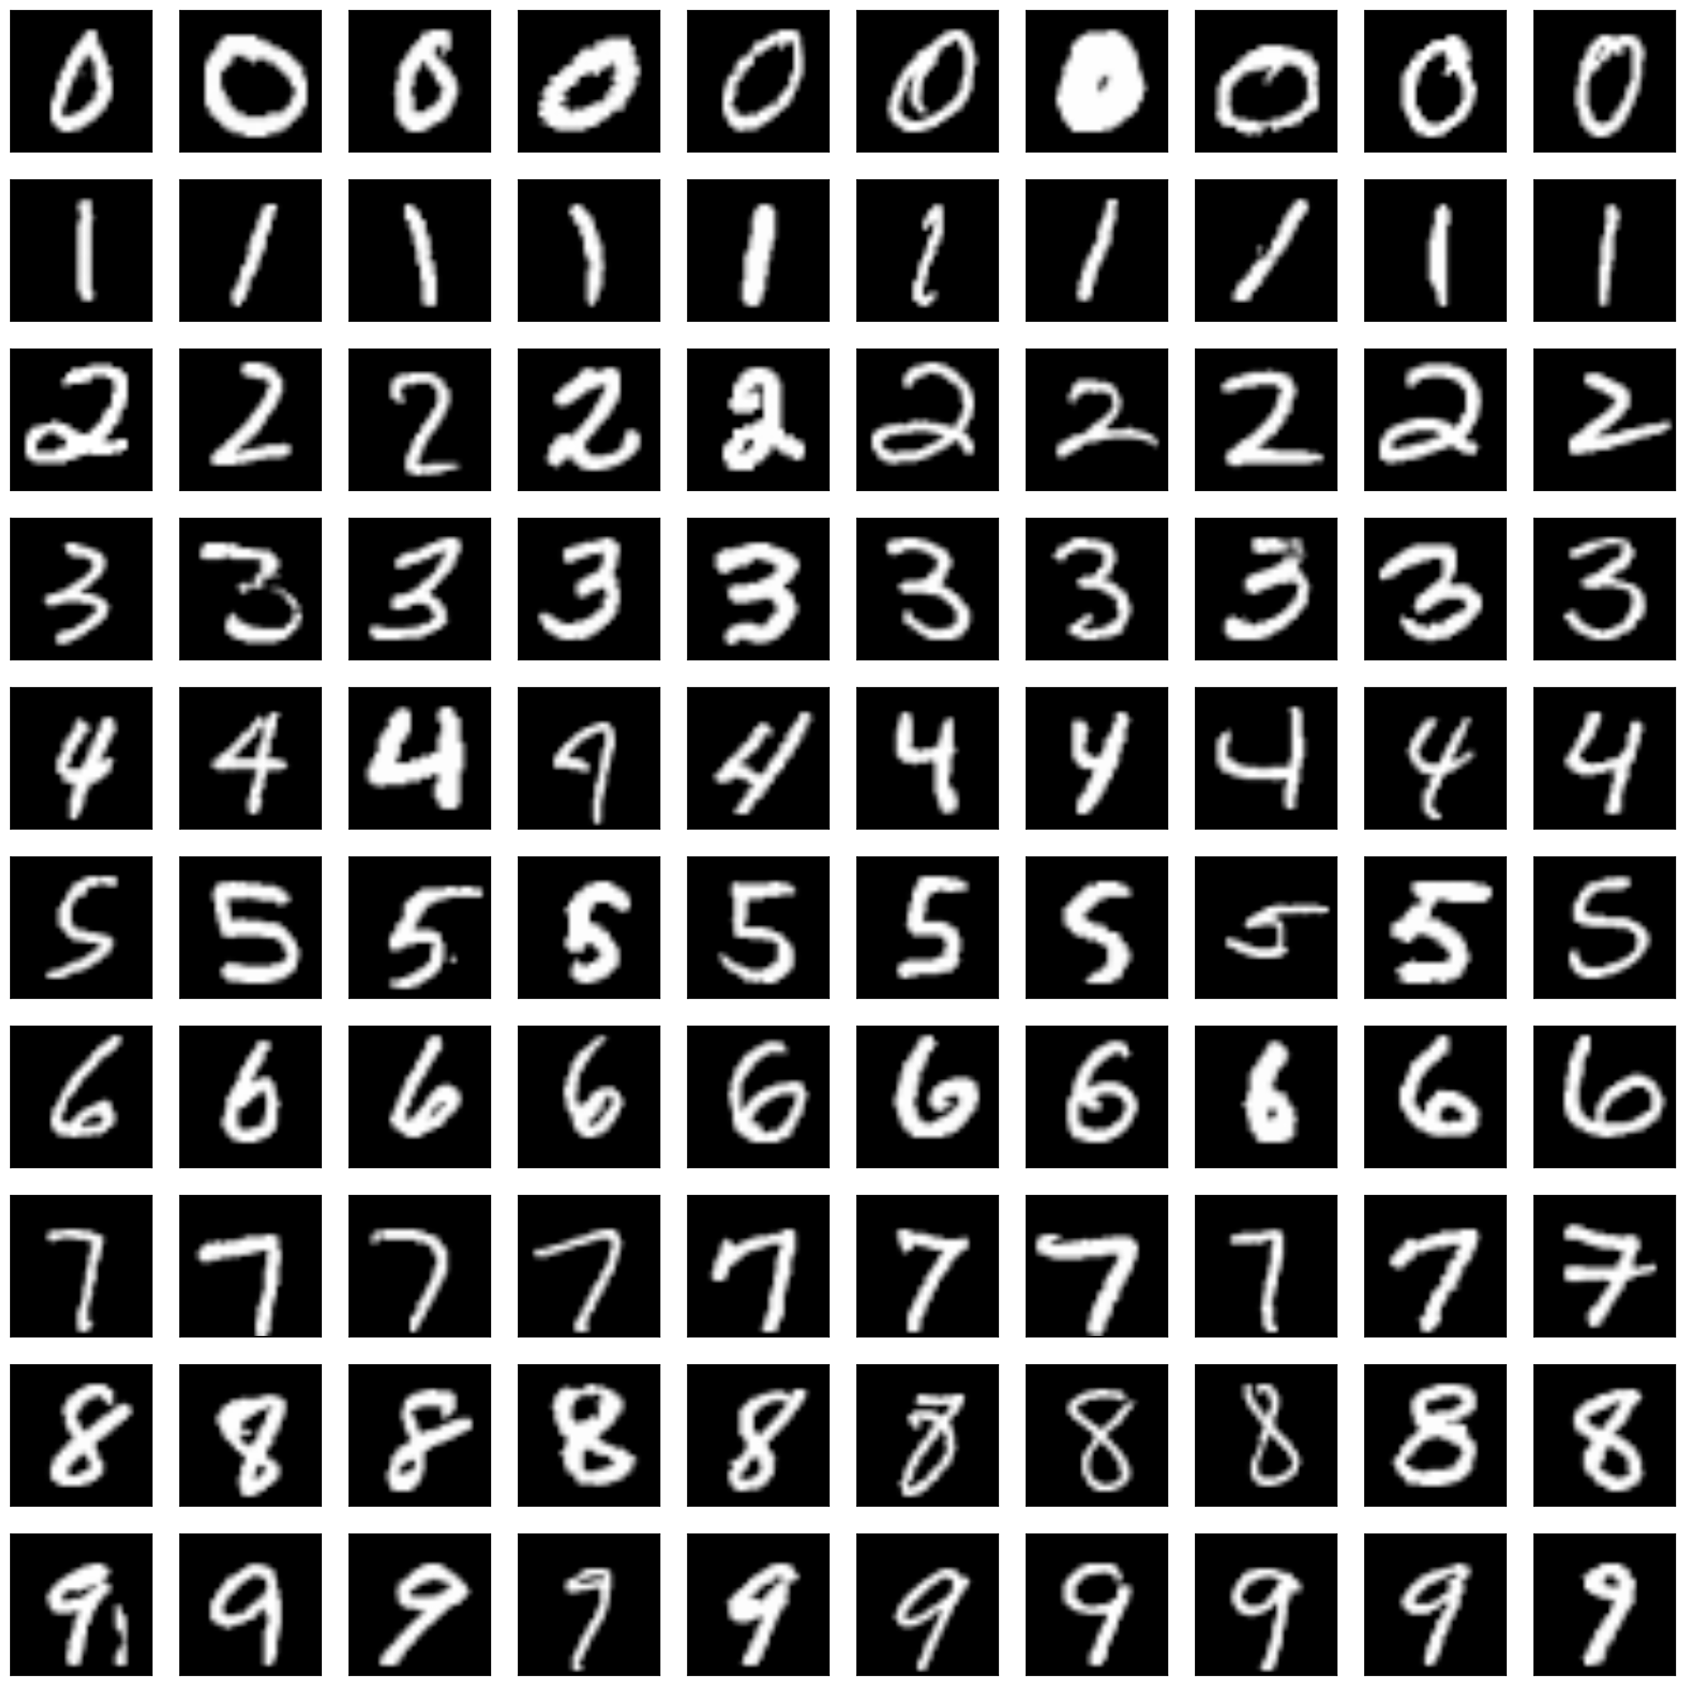
Better autoencoder
20 neurons
784 neurons

Slide 41
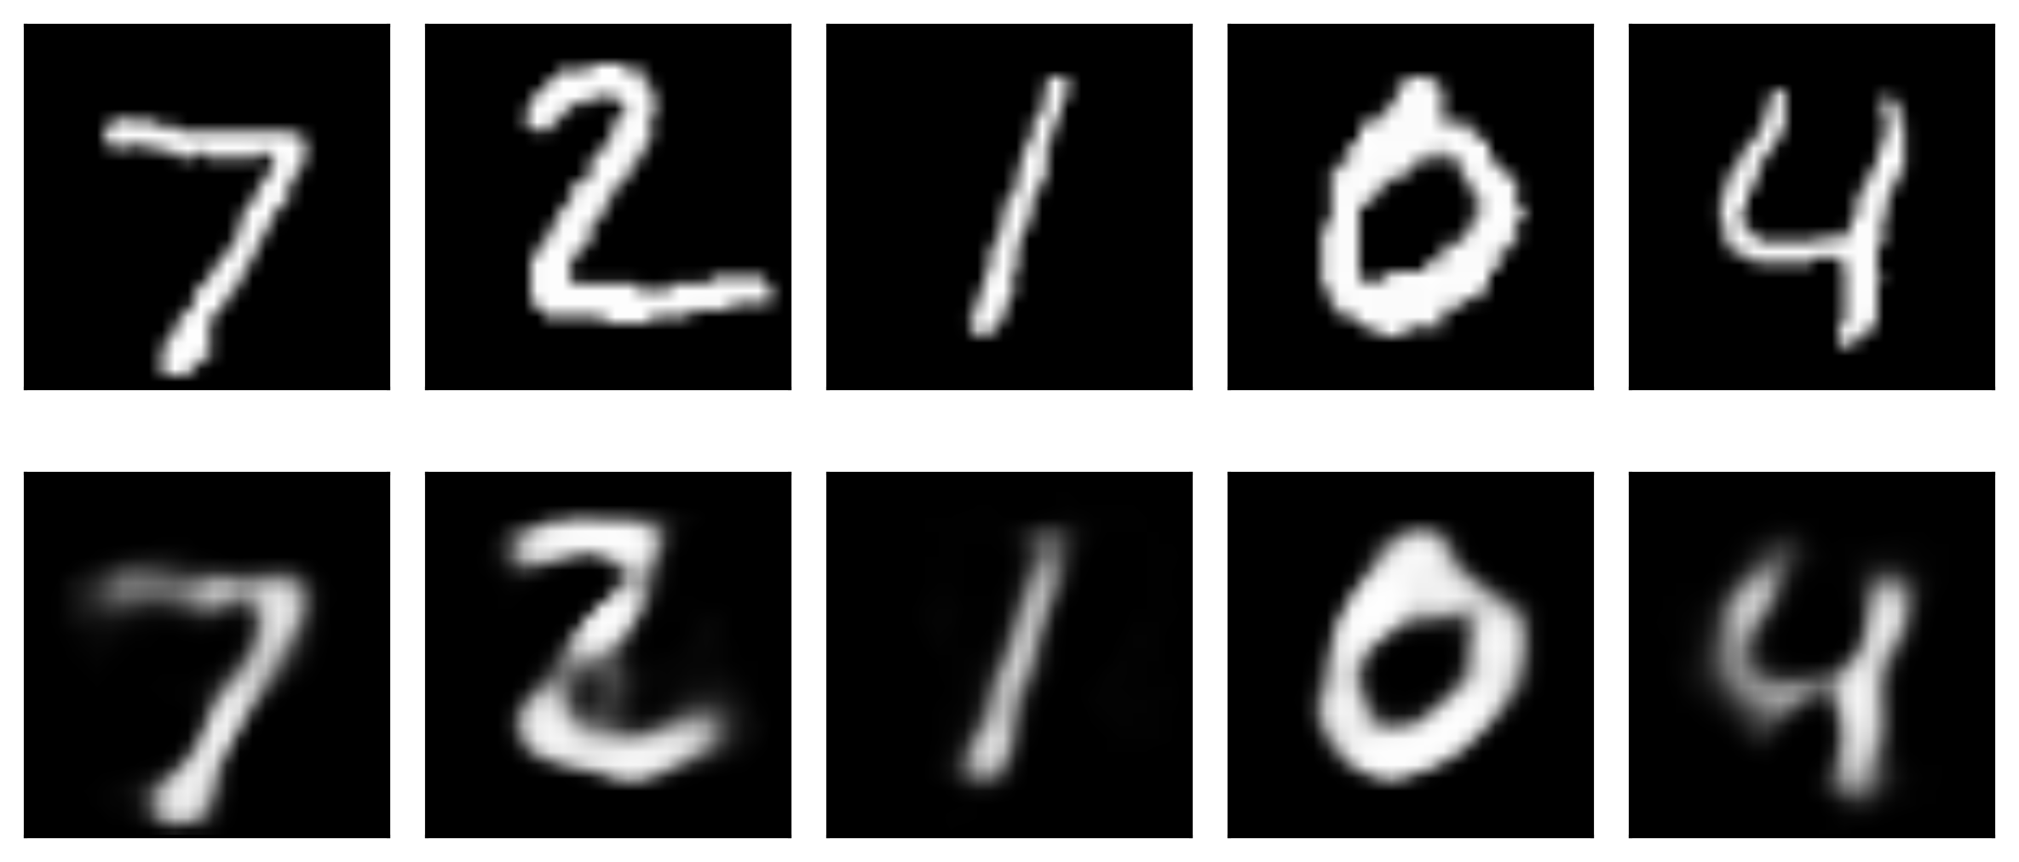
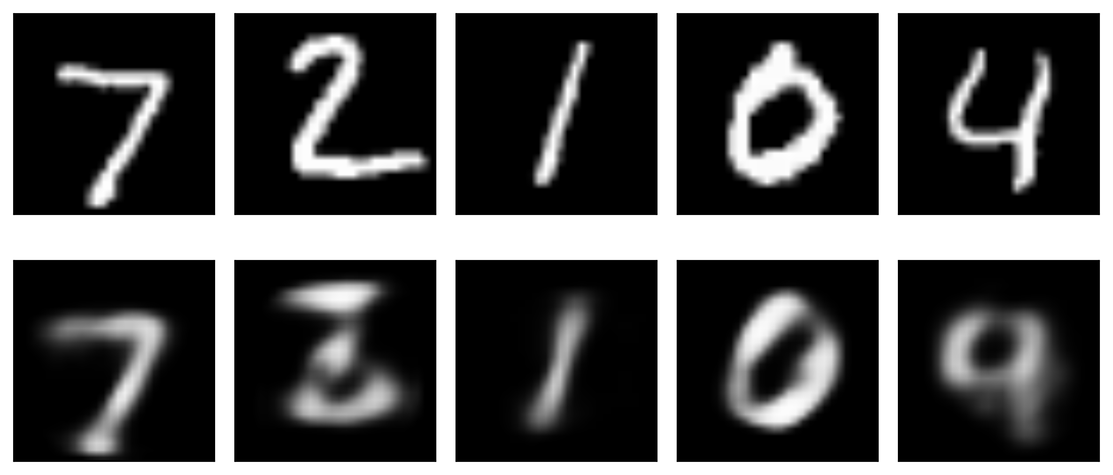
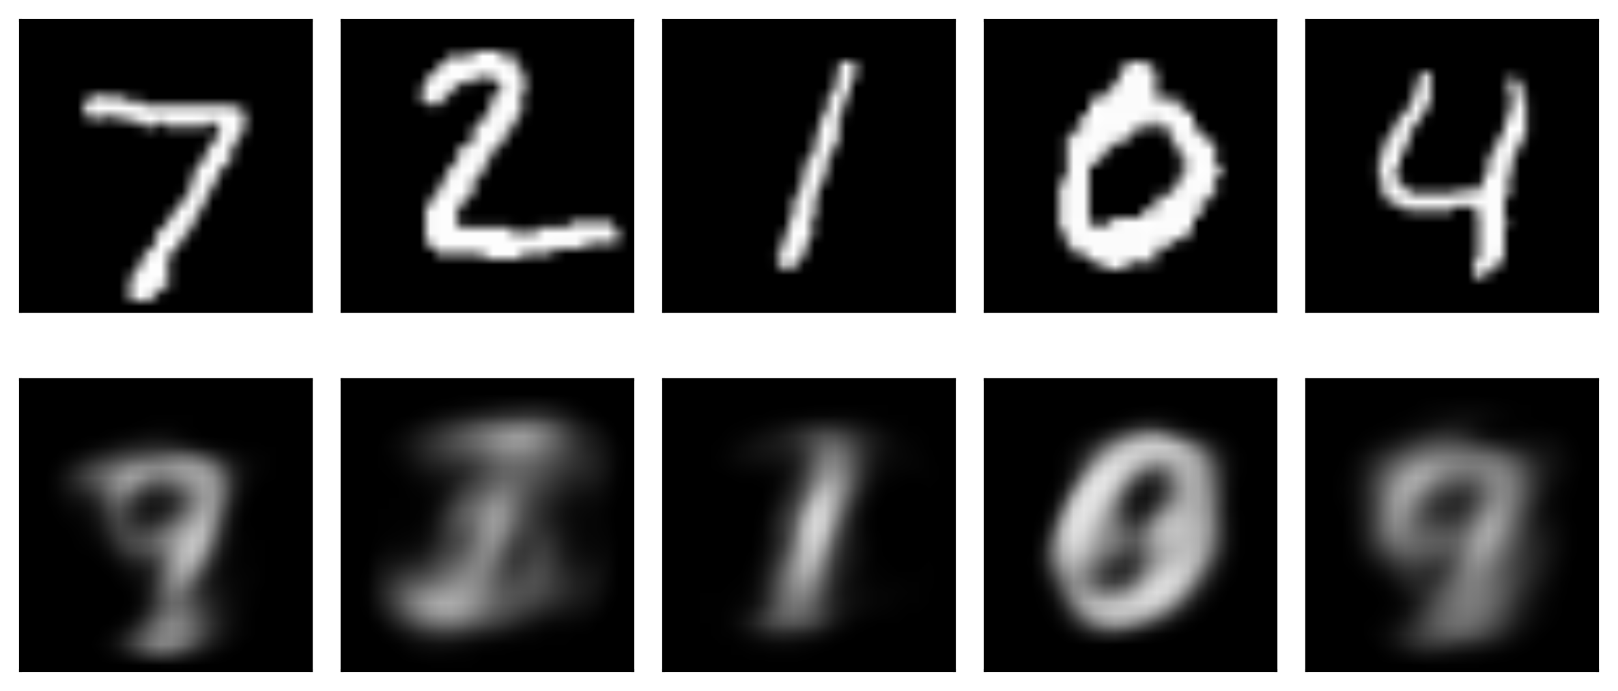
20 latent variables
10 latent variables
2 latent variables
Image taken from A. Glassner, Deep Learning, Vol. 2: From Basics to Practice

Slide 42
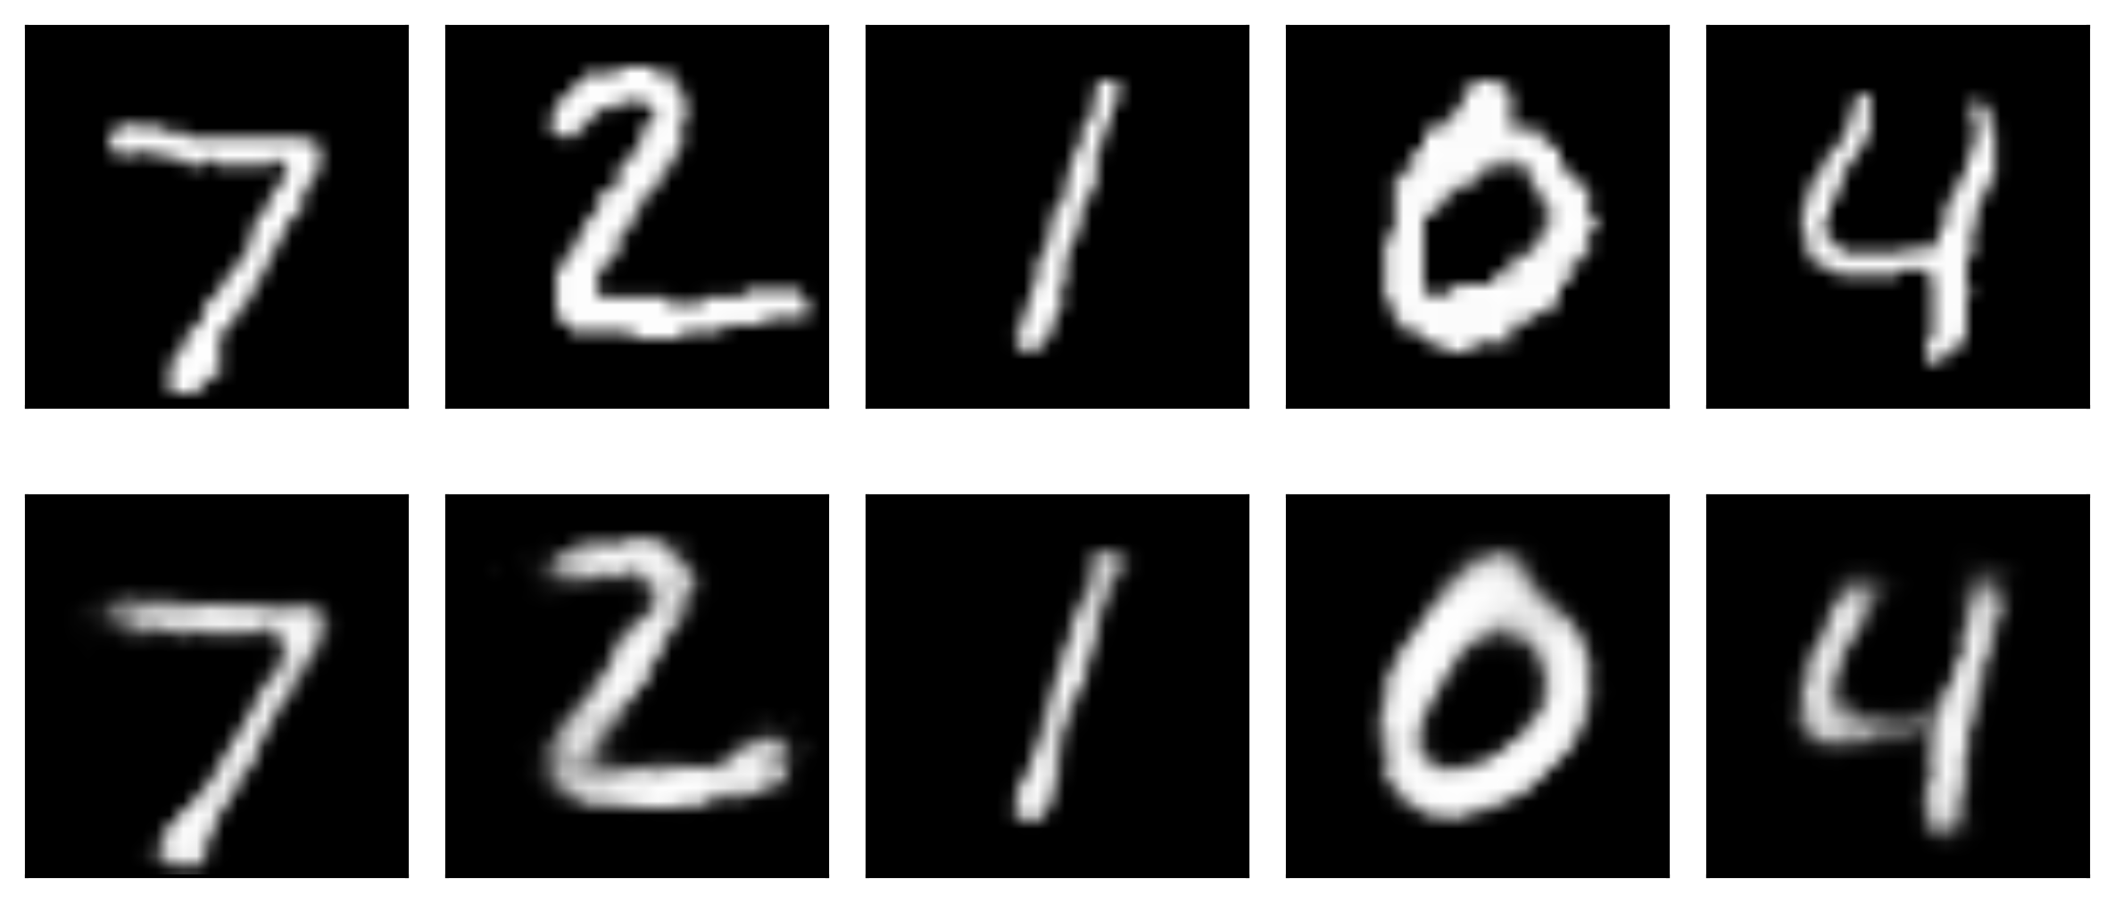
Go deeper
512 neurons
256 neurons
20 neurons
256 neurons
512neurons
784 neurons

Slide 43
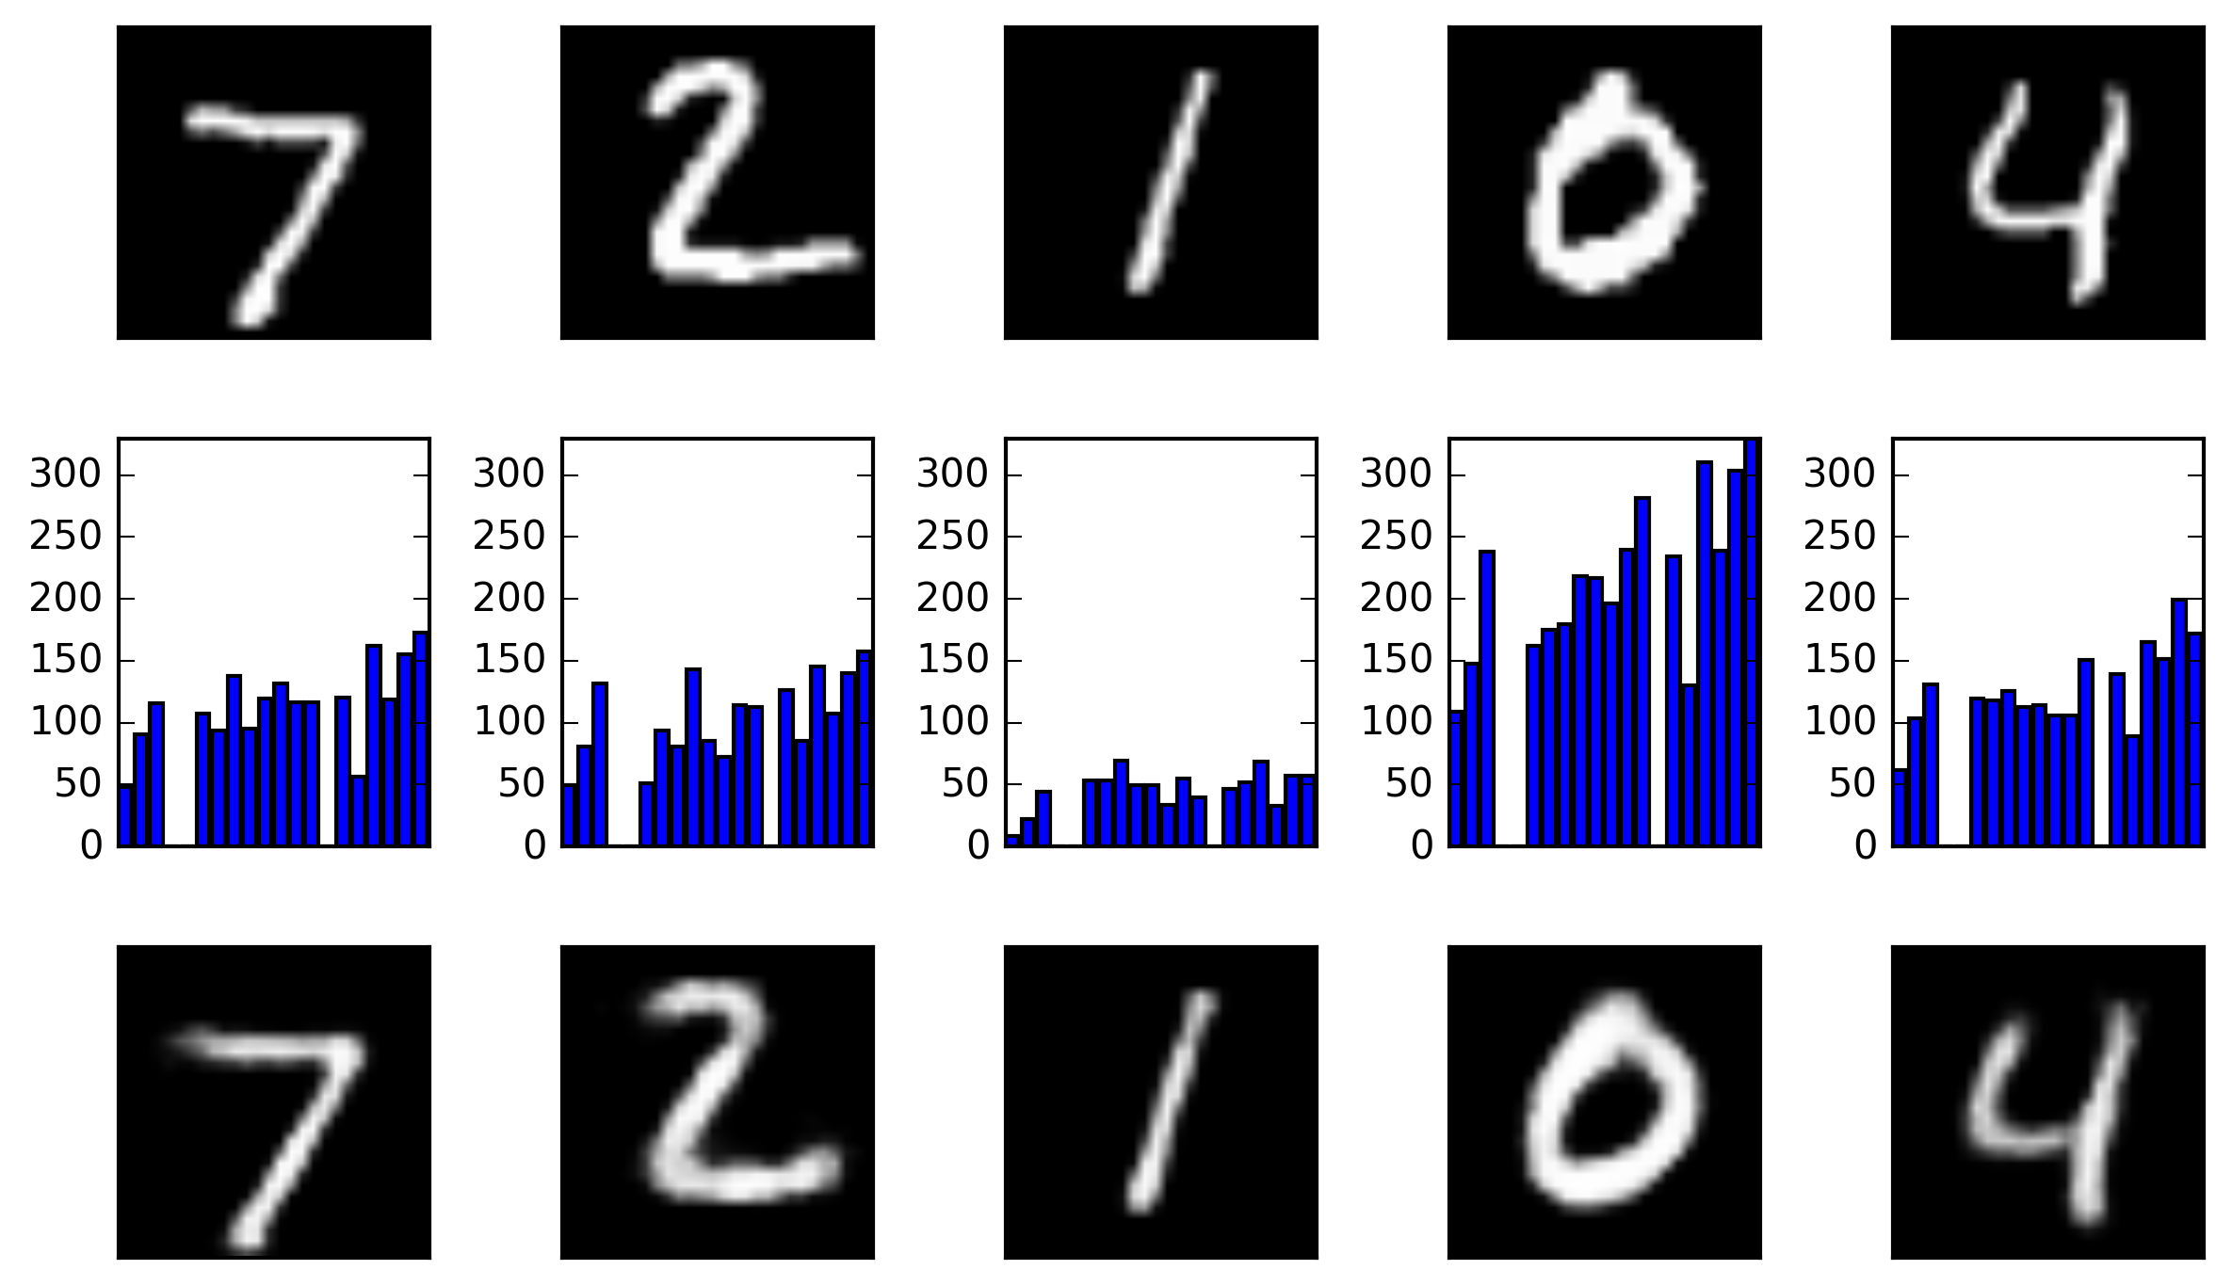
Exploring autoencoders

Slide 44
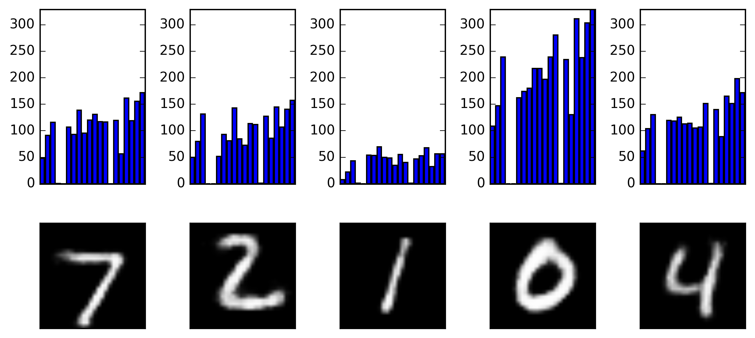
Exploring autoencoders
Change +/- 1 the latent variables

Slide 45

Exploring autoencoders
Change +/- 10 the latent variables

Slide 46
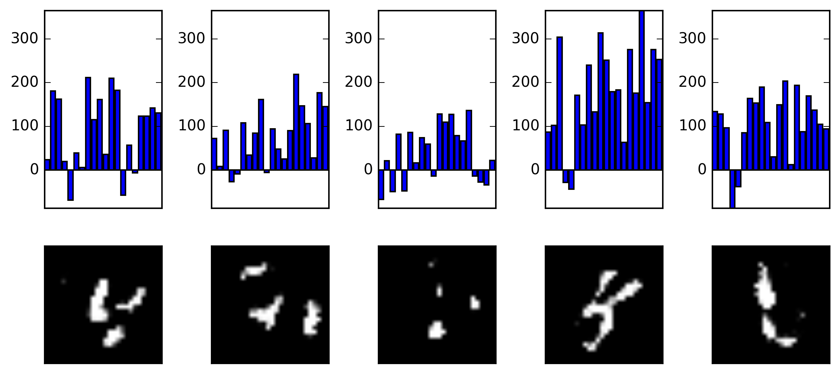
Exploring autoencoders
Change +/- 100 the latent variables

Slide 47
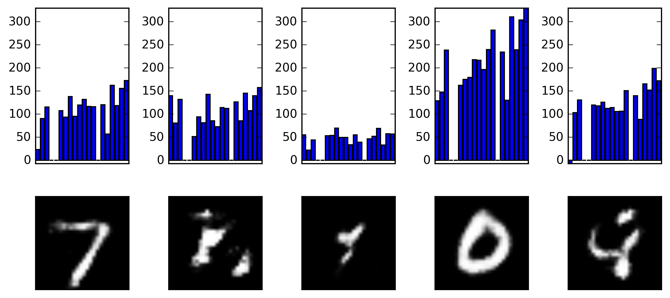
Exploring autoencoders
Change +/- 100 the first latent variables

Slide 48
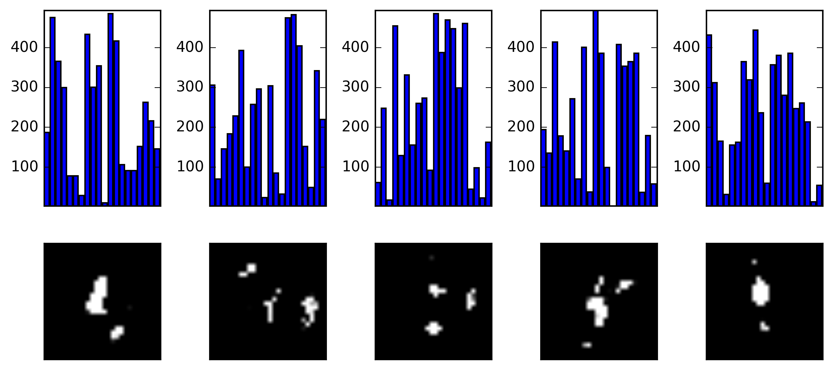
Exploring autoencoders
Just noise

Slide 49
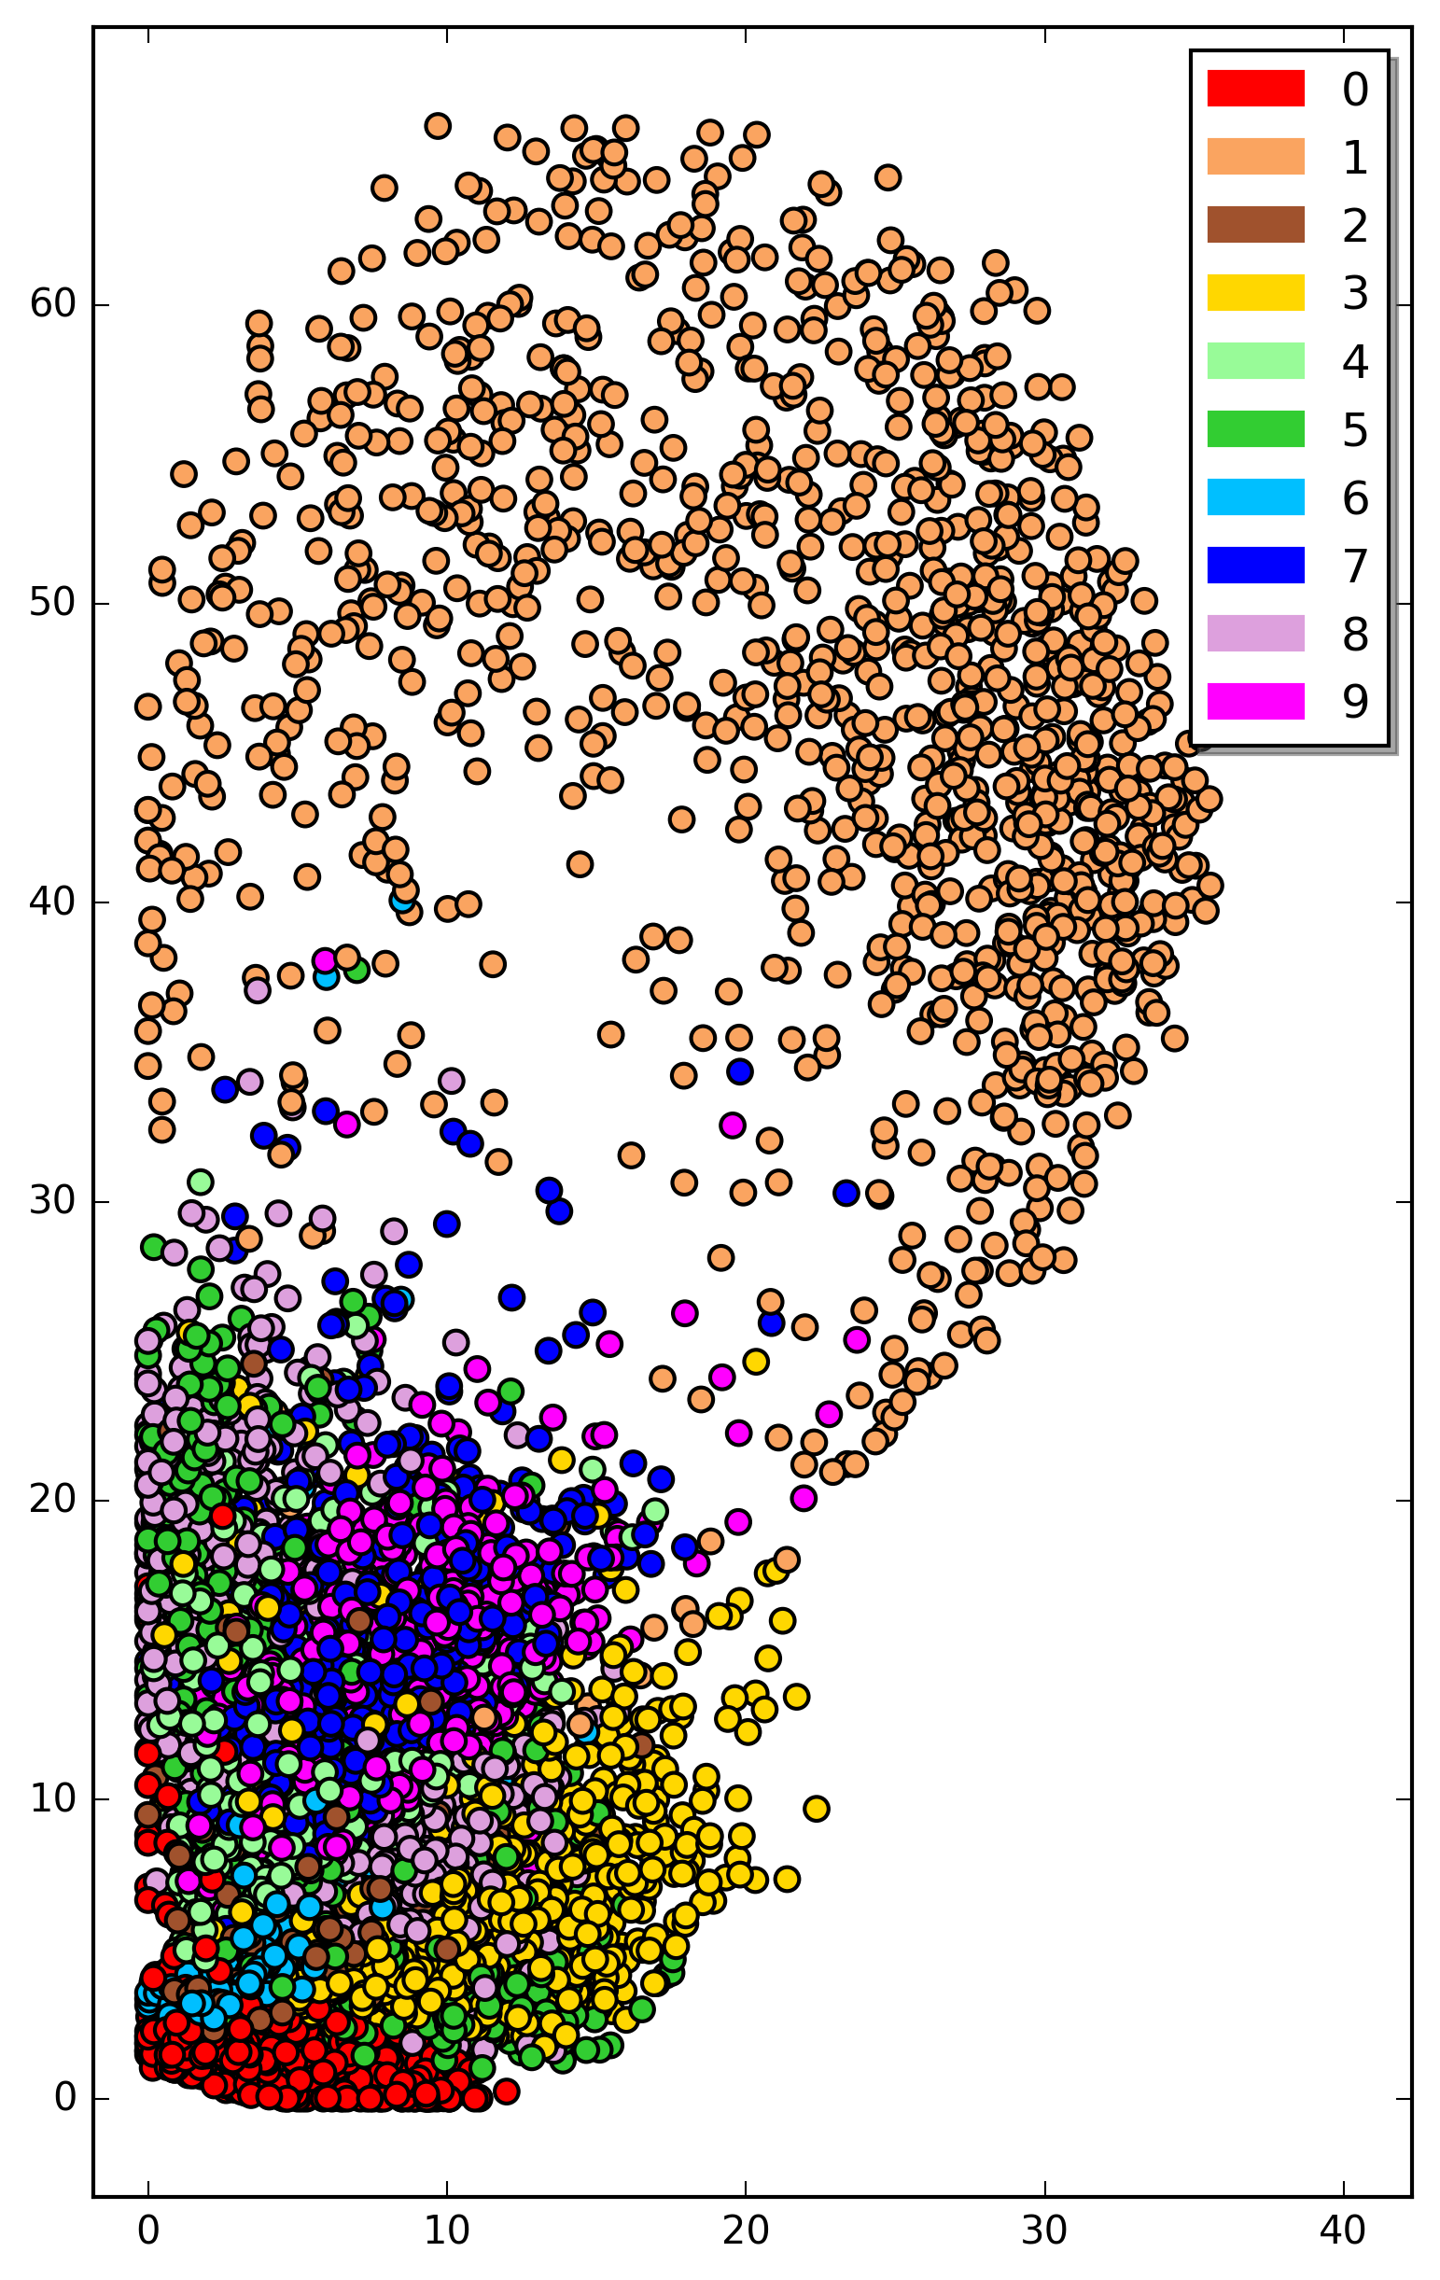
Parameter space of autoencoder

Slide 50
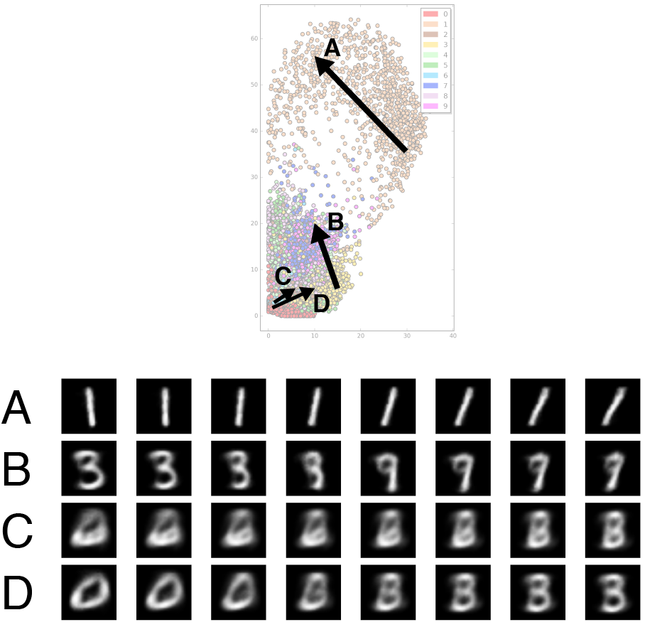
Blending Latent Variables

Slide 51
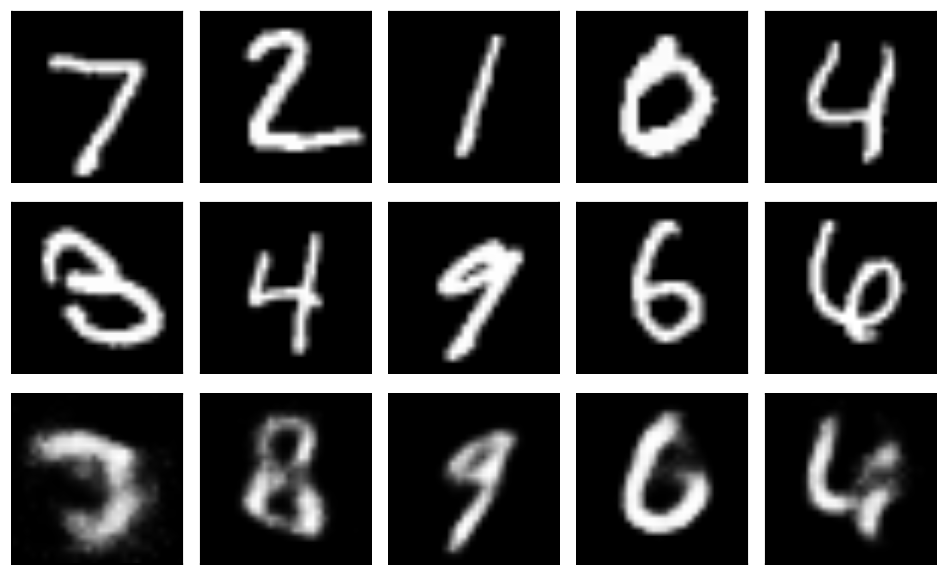
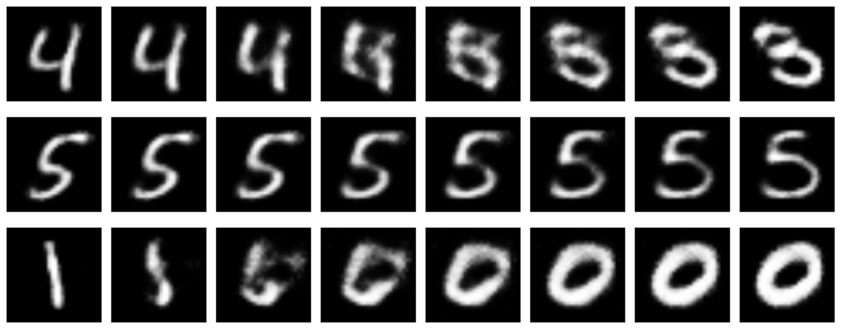
Blending Latent Variables

Slide 52
Applying to novel input
512 neurons
256 neurons
20 neurons
256 neurons
512neurons
784 neurons

Slide 53
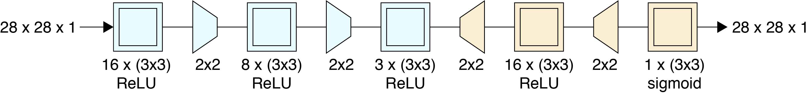
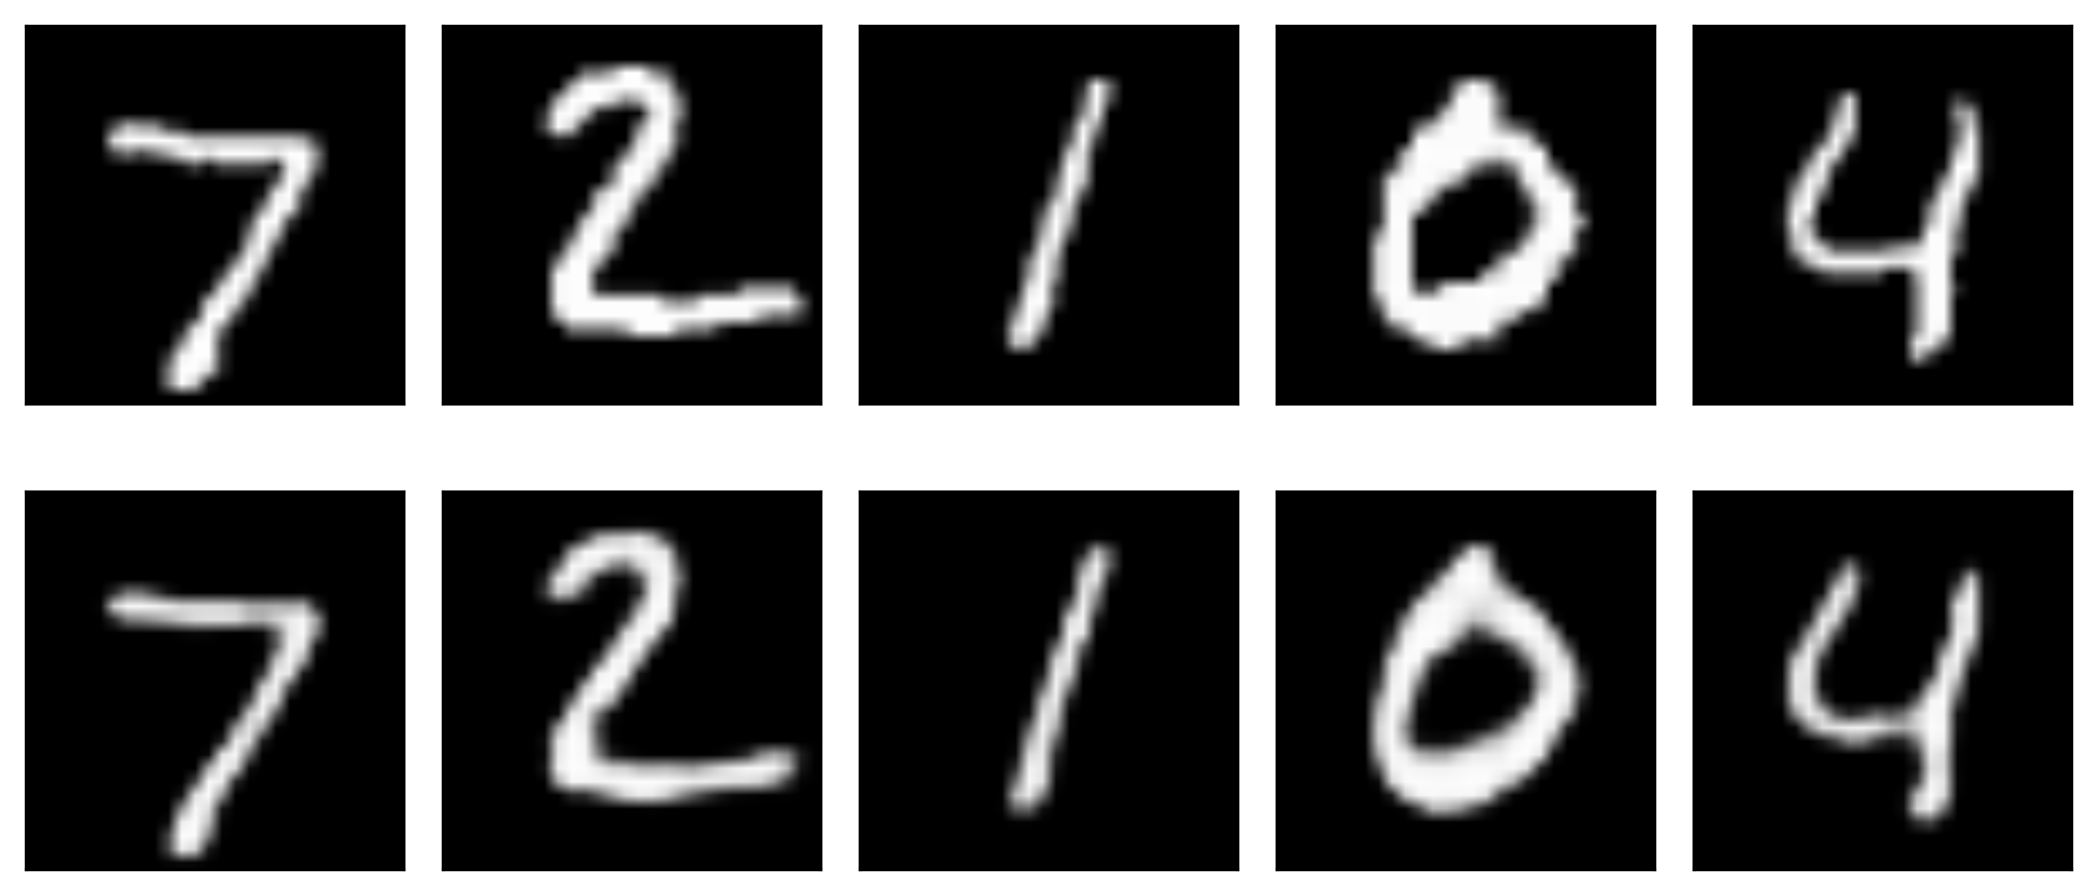
Convolutional Autoencoders

Slide 54
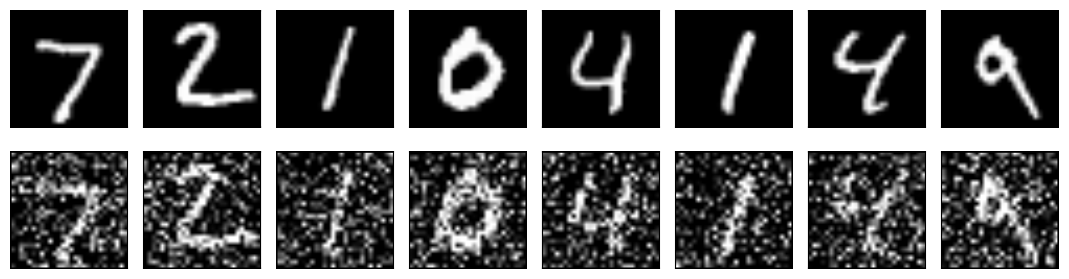
Denoising
A popular use of autoencoders is to remove noise from samples.

Slide 55
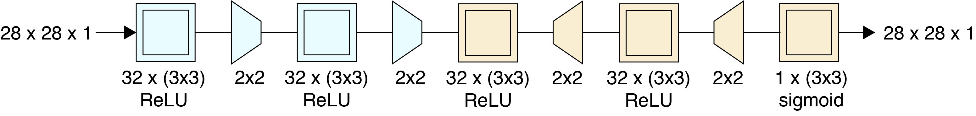
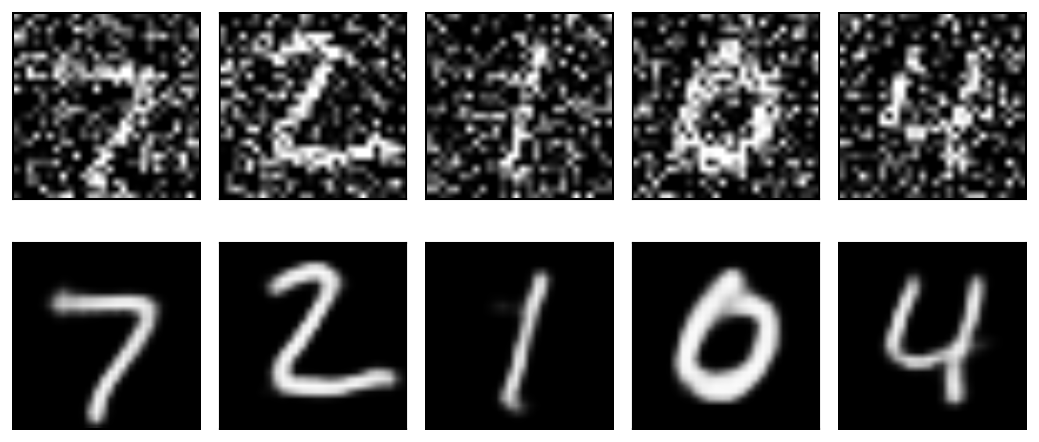
Denoising (cont)
A little strange that instead of bottleneck we have the opposite here.

Slide 56
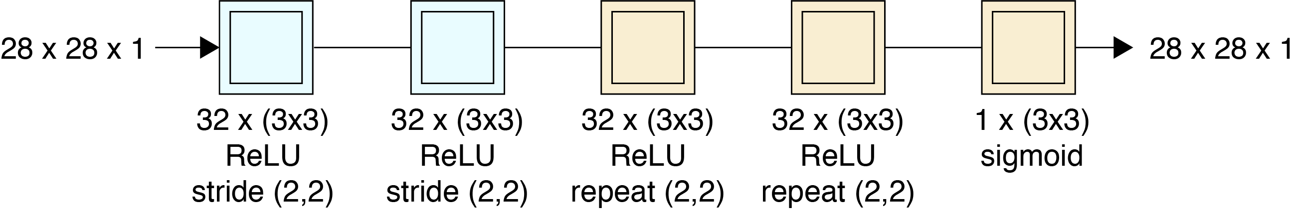
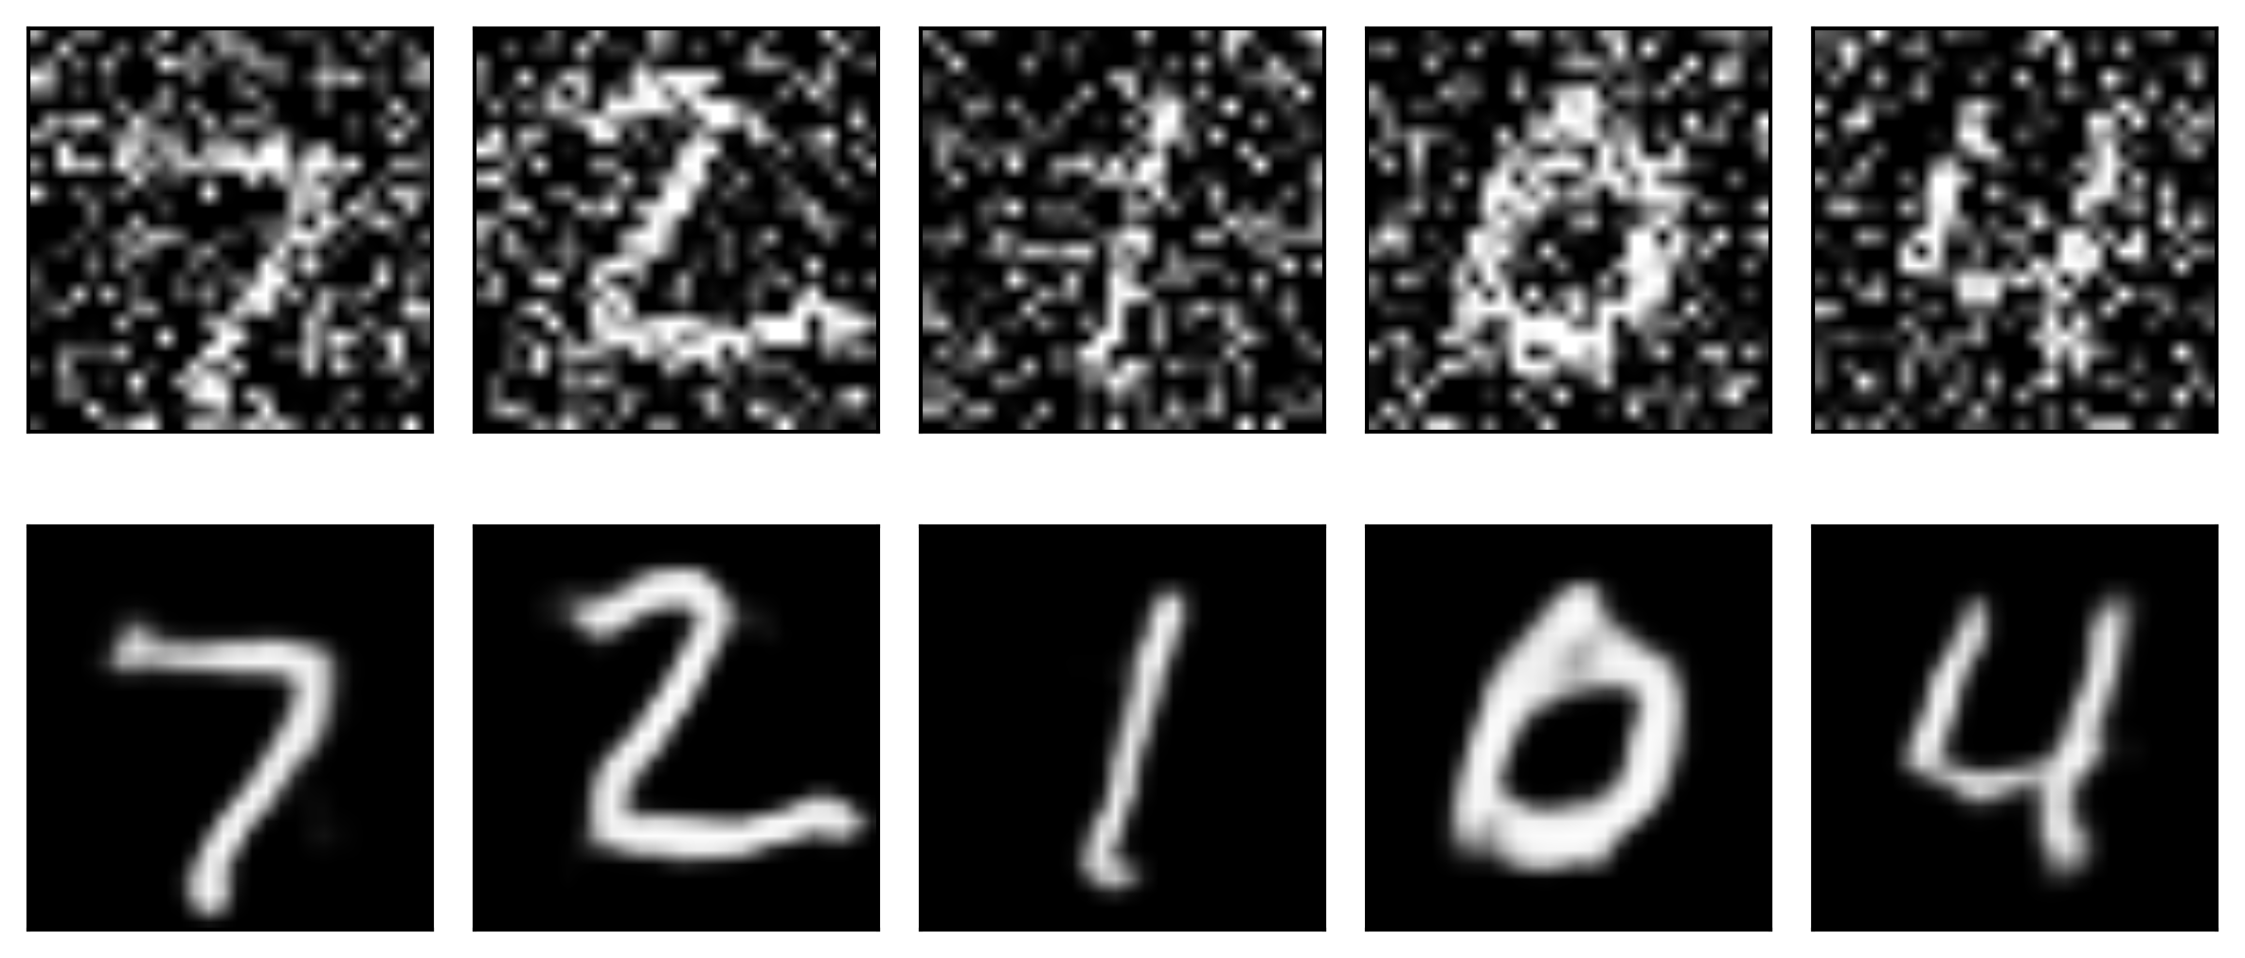
Denoising (cont)
Simpler model

Slide 57
Generative Models

Slide 58
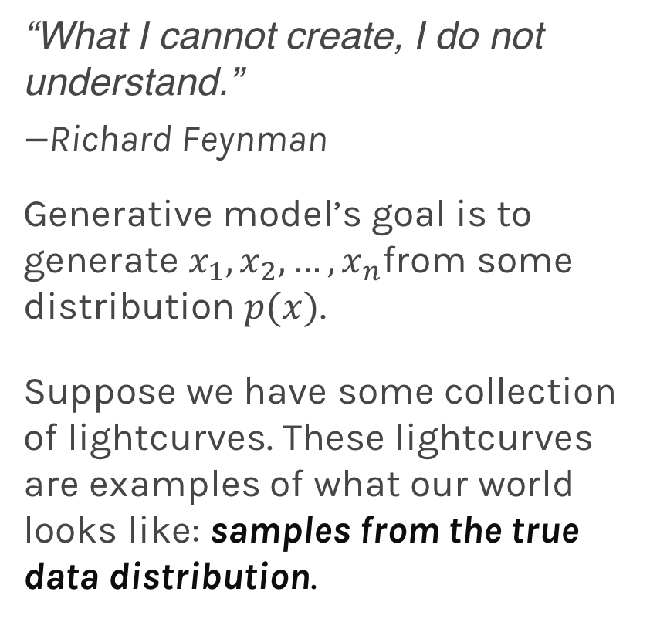
Generative models
“What I cannot create, I do not understand.”
—Richard Feynman
Generative model’s goal is to generate $x_{1},x_{2},…,x_{n}$from some distribution $p(x)$.
Suppose we have some collection of lightcurves. These lightcurves are examples of what our world looks like: samples from the true data distribution.

Slide 59
Generative models
We would like to construct our generative model, which we would like to train to generate lightcurves like these from scratch.
A generative model in this case could be one large neural network that outputs lightcurves: samples from the model.
Deep Generative Models
Explicit Density
Markov Chain
Implicit Density
Markov Chain
Direct
Variational
Boltzmann Machines
Deep Belief Networks
Variational
Auto-encoders (VAE)
Generative Adversarial Networks (GAN)
Generative Moment Matching Networks (GMM)

Slide 60
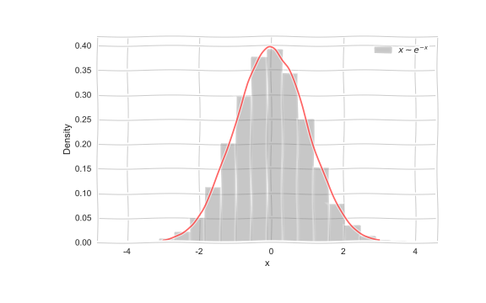
Generative models
Imagine we want to generate data from a distribution,
e.g.

Slide 61
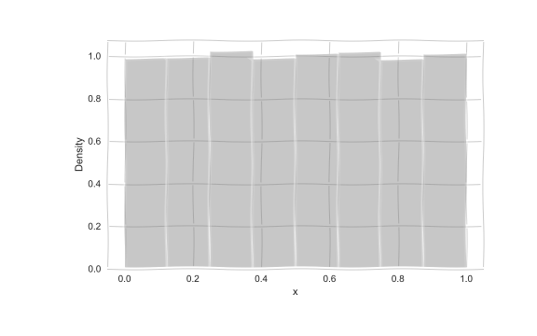
Generative models
But how do we generate such samples?
Imagine we want to generate:
We start with

Slide 62
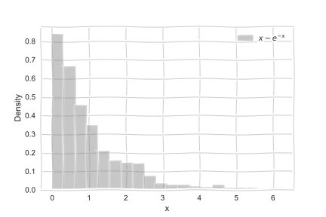
Generative models
The we transform:

Slide 63
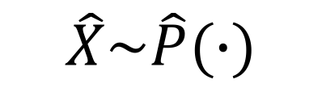
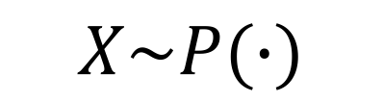
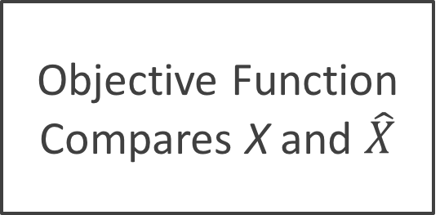
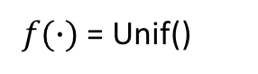
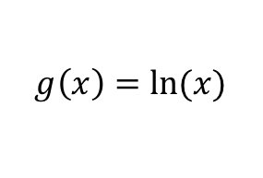
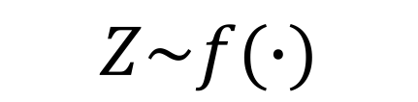
Generative models
Generator
g(X)
$$Z\sim f(∙)$$
$$\hat{X}\sim \hat{P}(∙)$$
$f(∙)$ = Unif()
Objective Function Compares X and $\hat{X}$
$$g\left(x\right)=ln⁡(x)$$
Either a likelihood or KL divergence, etc
$$X\sim P(∙)$$

Slide 64
Outline
Why do we care about training sets
How do we generate training sets
Overview of transfer learning and domain adaptation
Generative models
NN Generative Models
Our method
Results

Slide 65

Autoencoders
Neural net that approximately copies its input to output
Encodes useful info about data

Slide 66
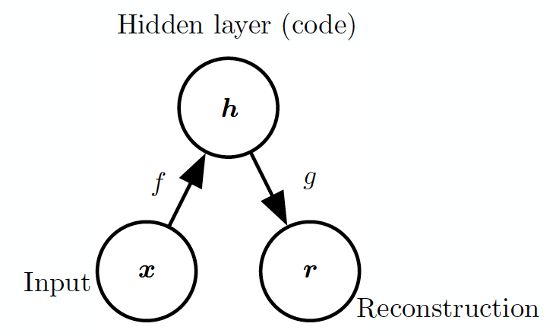
Structure of Autoencoders

Slide 67
Undercomplete Autoencoders
h has lower dimension than x
Must discard some information in h
Learning involves minimizing loss:
Equivalent to PCA when f is linear, L is MSE

Slide 68
Overcomplete Autoencoders
h has greater dimension than x
Autoencoder may simply copy input to output without learning anything useful
Regularization to limit model capacity

Slide 69
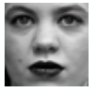
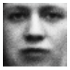
Variational Autoencoders
Encoder
z
Decoder

Slide 70
Variational Autoencoders
Encoder
z
Decoder

Slide 71
Variational Autoencoder
Sample from P(z)
Standard Gaussian
z
Decoder
P(x|z)

Slide 72
VAE Likelihood
Neural network
Difficult to approximate in high dim through sampling
For most z values p(x|z) close to 0

Slide 73
VAE Likelihood
Another neural net
Proposal distribution:
Likely to produce values of x for which p(x|z) is non-zero

Slide 74
VAE Architecture
q_{ϕ}(z|x)
Encoder
z
Decoder
p_{θ}(x|z)
Notes:
http://kvfrans.com/variational-autoencoders-explained/
https://arxiv.org/pdf/1606.05908.pdf

Slide 75
VAE Loss
Proposal distribution should resemble a Gaussian
Reconstruction Loss

Slide 76
VAE Loss
Proposal distribution should resemble a Gaussian
Reconstruction Loss

Slide 77
VAE Loss
Proposal distribution should resemble a Gaussian
Reconstruction Loss
Variational upper bound on loss we care about!

Slide 78
Training VAE
Apply stochastic gradient descent
Sampling step not differentiable
Use a re-parameterization trick
Move sampling to input layer, so that the sampling step is independent of the model

Slide 79
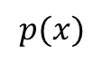
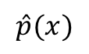
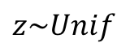
Generative Adversarial Networks
Generated distribution
True distribution
$$\hat{p}(x)$$
$$p(x)$$
Generative Model
(Neural Network)
W_{G}
$$z\sim Unif$$
Loss function
KL Divergence

Slide 80
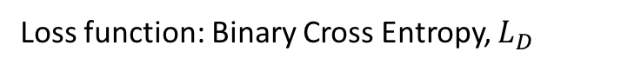
Generative Adversarial Networks
Generated distribution
True distribution
$$\hat{p}(x)$$
$$p(x)$$
Generative Model
(Neural Network)
W_{G}
Discriminator
(Neural Network)
W_{D}
$$z\sim Unif$$
From Generator
From True Distribution
Loss function
KL Divergence
Loss function: Binary Cross Entropy, $L_{D}$

Slide 81




Generative Adversarial Networks
Generated distribution
True distribution
$$\hat{p}(x)$$
$$p(x)$$
Generative Model
(Neural Network)
$$z\sim Unif$$
Discriminator
(Neural Network)
From Generator
From True Distribution

Slide 82

Generative Adversarial Networks
Generated distribution
True distribution
$$\hat{p}(x)$$
$$p(x)$$
Generative Model
(Neural Network)
$$z\sim Unif$$
Discriminator
(Neural Network)
From Generator
From True Distribution

Slide 83

Generative Adversarial Networks
Generated distribution
True distribution
$$\hat{p}(x)$$
$$p(x)$$
Generative Model
(Neural Network)
$$z\sim Unif$$
Adjust
weights by
$$∇_{W_{G}}L_{D}$$
Discriminator
(Neural Network)
Generator
Loss
From Generator
From True Distribution

Slide 84

Generative Adversarial Networks
Generated distribution
True distribution
$$\hat{p}(x)$$
$$p(x)$$
Generative Model
(Neural Network)
$$z\sim Unif$$
Discriminator
(Neural Network)
From Generator
From True Distribution

Slide 85

Generative Adversarial Networks
Generated distribution
True distribution
$$\hat{p}(x)$$
$$p(x)$$
Generative Model
(Neural Network)
$$z\sim Unif$$
Discriminator
(Neural Network)
Adjust
weights by
$$∇_{W_{G}}L_{D}$$
Generator
Loss
From Generator
From True Distribution

Slide 86

Generative Adversarial Networks
Generated distribution
True distribution
$$\hat{p}(x)$$
$$p(x)$$
Generative Model
(Neural Network)
$$z\sim Unif$$
Discriminator
(Neural Network)
From Generator
From True Distribution

Slide 87

Generative Adversarial Networks
Generated distribution
True distribution
$$\hat{p}(x)$$
$$p(x)$$
Generative Model
(Neural Network)
$$z\sim Unif$$
Adjust
weights by
$$∇_{W_{D}}L_{D}$$
Discriminator
(Neural Network)
Discriminator
Loss
From Generator
From True Distribution

Slide 88


Generative Adversarial Networks
Generated distribution
True distribution
$$\hat{p}(x)$$
$$p(x)$$
Generative Model
(Neural Network)
$$z\sim Unif$$
Discriminator
(Neural Network)
Adjust
weights by
$$∇_{W_{G}}L_{D}$$
Generator
Loss
From Generator
From True Distribution

